Slide 1
Operating System
Unit II
Srinivas Koppu
Asst.Professor
SITE

Slide 2
Roadmap ( PROCESS MANAGEMENT )
Scheduling:
Preemptive and non-preemptive scheduling; scheduling policies
Concurrency:
Mutual exclusion
deadlock detection and prevention; solution strategies; models and mechanisms
(semaphores, monitors, condition variables, rendezvous); producer-consumer problems; synchronization; multiprocessor issues

Slide 3
Process Concept
An operating system executes a variety of programs:
Batch system – jobs
Time-shared systems – user programs or tasks
uses the terms job and process almost interchangeably.
Process – a program in execution; process execution must progress in sequential fashion.
A process includes:
program counter
stack
data section

Slide 4
What is a “process” ?
A program in execution
An instance of a program running on a computer
The entity that can be assigned to and executed on a processor
A unit of activity characterized by the execution of a sequence of instructions, a current state, and an associated set of system instructions.

Slide 5
Process State
As a process executes, it changes state
new: The process is being created.
running: Instructions are being executed.
waiting: The process is waiting for some event to occur.
ready: The process is waiting to be assigned to a process.
terminated: The process has finished execution.

Slide 6
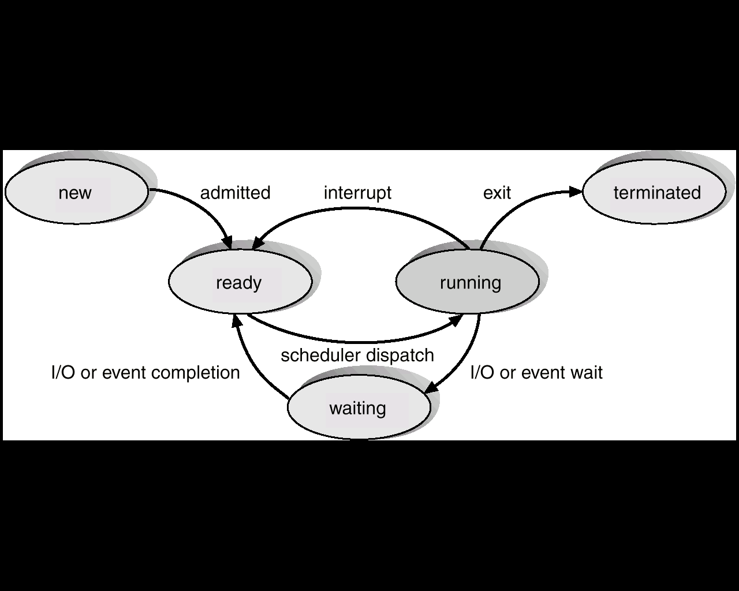
Diagram of Process State

Slide 7
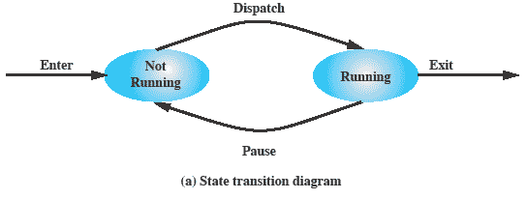
Two-State Process Model
Process may be in one of two states
Running
Not-running

Slide 8
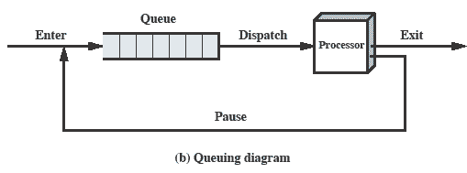
Queuing Diagram
Etc … processes moved by the dispatcher of the OS to the CPU then back to the queue until the task is competed

Slide 9
Process Birth and Death
Creation Termination
New batch job Normal Completion
Interactive Login Memory unavailable
Created by OS to
provide a service Protection error
Spawned by
existing process Operator or OS Intervention

Slide 10
Process Creation
The OS builds a data structure to manage the process
Traditionally, the OS created all processes
But it can be useful to let a running process create another
This action is called process spawning
Parent Process is the original, creating, process
Child Process is the new process

Slide 11
Process Termination
There must be some way that a process can indicate completion.
This indication may be:
A HALT instruction generating an interrupt alert to the OS.
A user action (e.g. log off, quitting an application)
A fault or error
Parent process terminating

Slide 12
Process Control Block (PCB)
Information associated with each process.
Process state
Program counter
CPU registers
CPU scheduling information
Memory-management information
Accounting information
I/O status information

Slide 13
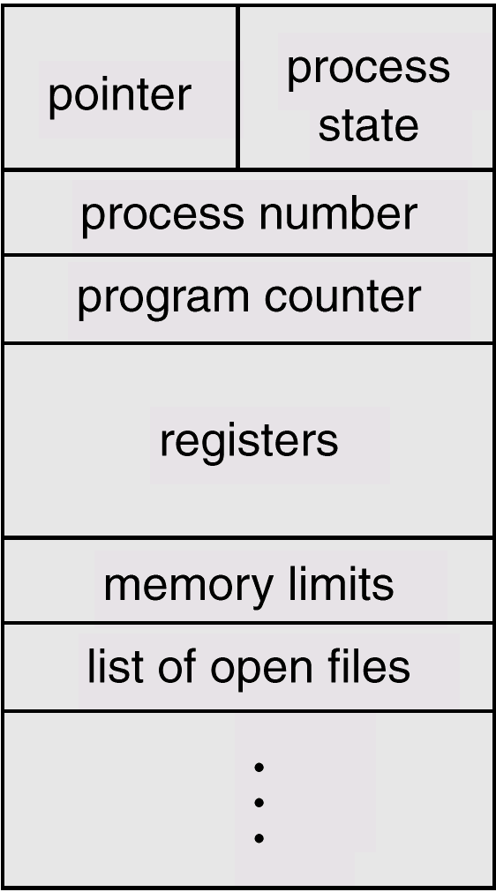
Process Control Block (PCB)

Slide 14
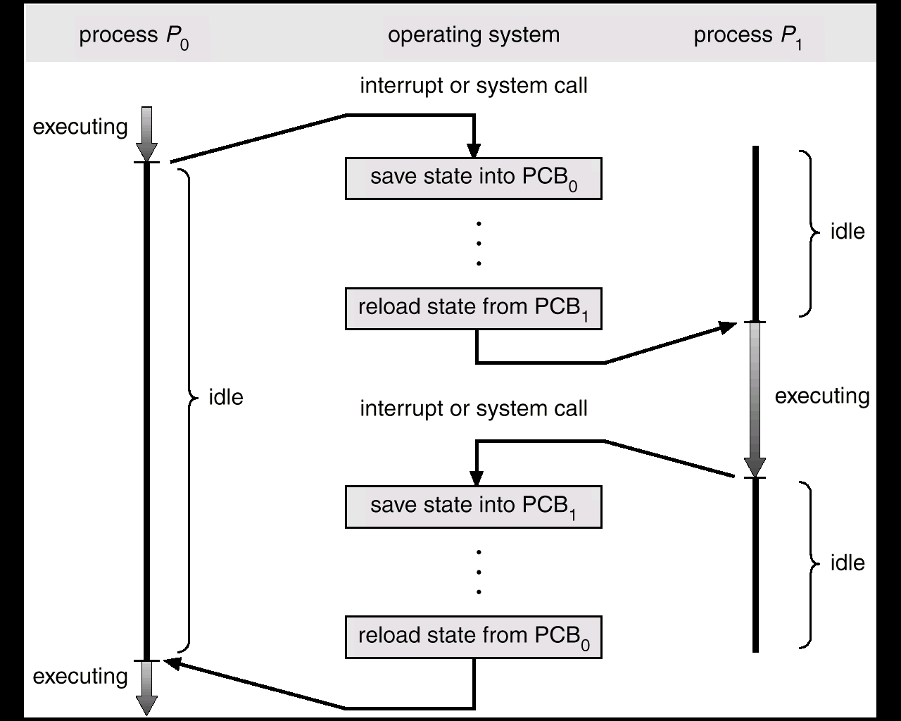
CPU Switch From Process to Process

Slide 15
Process Scheduling Queues
Job queue – set of all processes in the system.
Ready queue – set of all processes residing in main memory, ready and waiting to execute.
Device queues – set of processes waiting for an I/O device.
Process migration between the various queues.

Slide 16
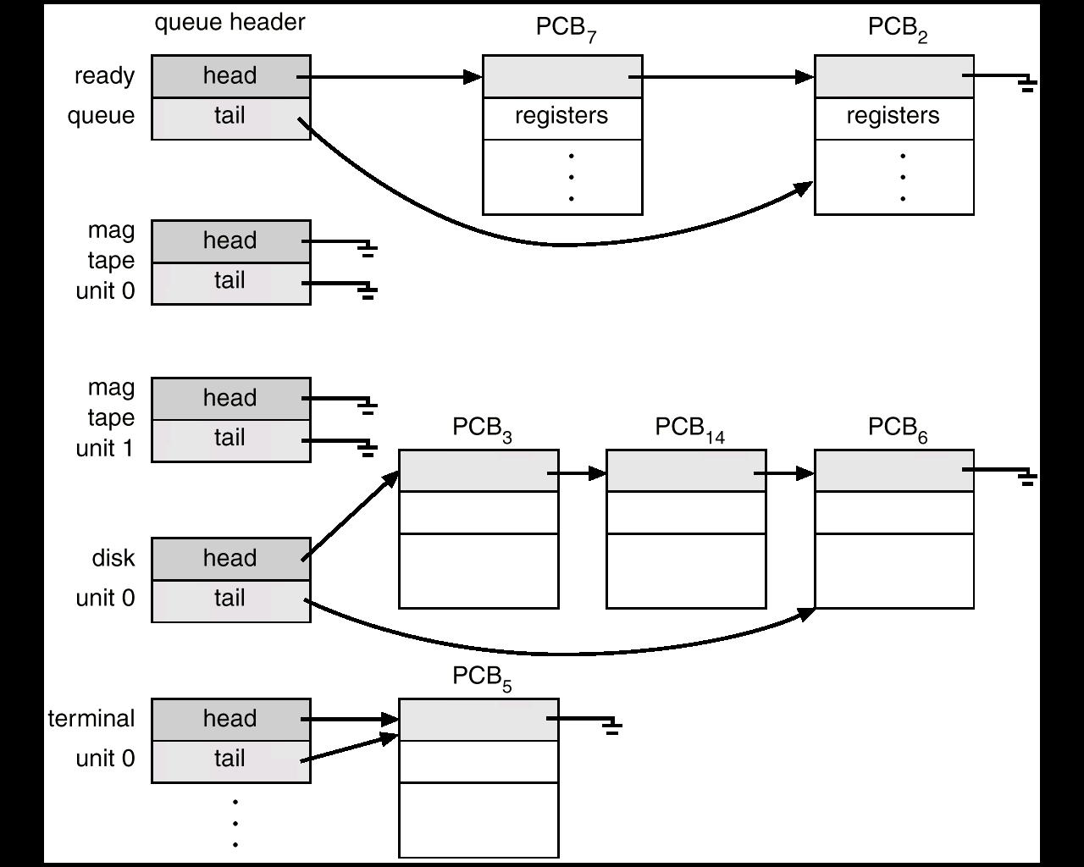
Ready Queue And Various I/O Device Queues

Slide 17
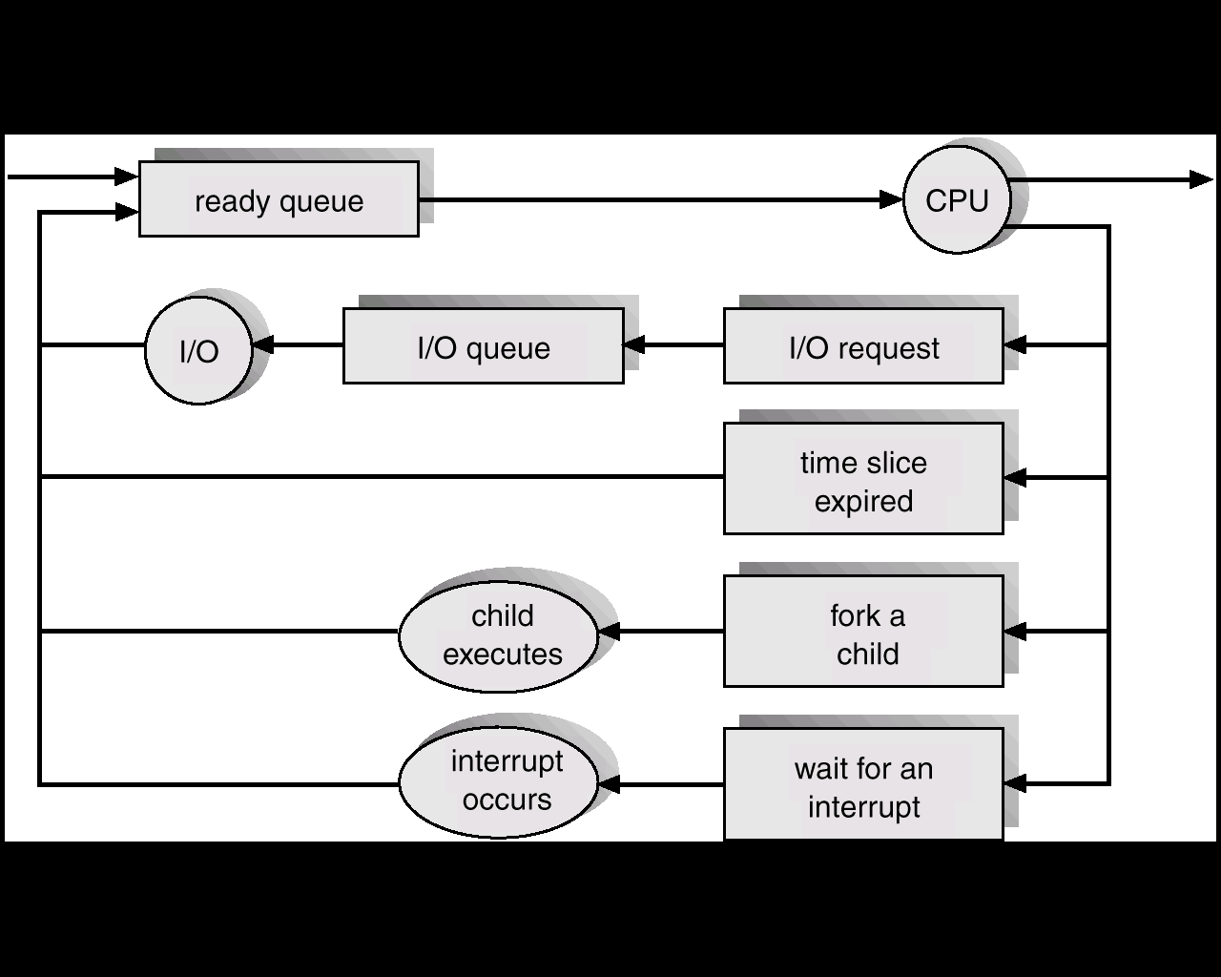
Representation of Process Scheduling

Slide 18
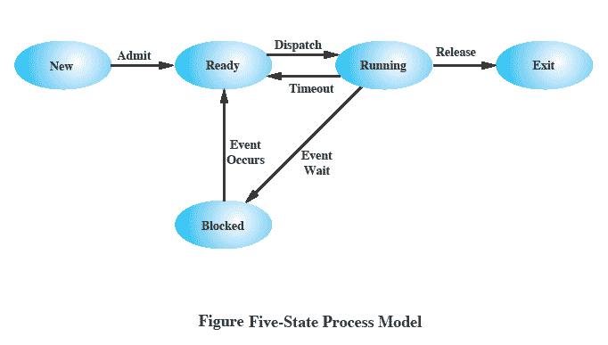
Five-State Process Model
Notes:
If all processes were always ready to execute, then the simple FIFO queuing model would suffice.
However, even with simple examples, this implementation is inadequate:
some processes in the Not Running state are ready to execute,
while others are blocked, waiting for an I/O operation to complete.
In a two state model, the dispatcher would have to scan the list looking for the process that is not blocked and that has been in the queue the longest.
But we could split the Not Running state into two states:
Ready and
Blocked.
For good measure, we have added two additional states that will prove useful (new and exit)
Suggestion:
Mention that “Wait” and “Blocked” have the same meaning here.
Talk through the state transitions.
18

Slide 19
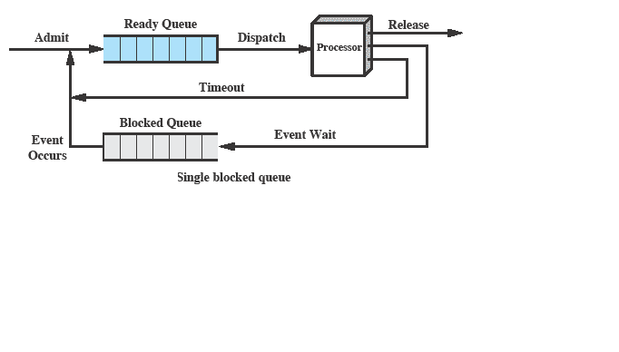
Using Two Queues
Notes:
In the simplest solution, this model would require an additional queue for the blocked processes.
But when an event occurs the dispatcher would have to cycle through the entire queue to see which process is waiting for the event.
This can cause huge overhead when their may be 100’s or 1000’s of processes
19

Slide 20
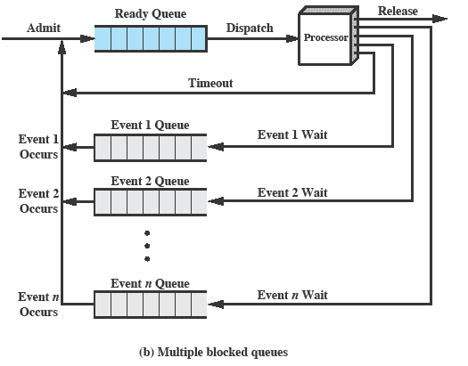
Multiple Blocked Queues
Notes:
More efficient to have a separate ‘blocked’ queue for each type of event.
20

Slide 21
Suspended Processes
Processor is faster than I/O so all processes could be waiting for I/O
Swap these processes to disk to free up more memory and use processor on more processes
Blocked state becomes suspend state when swapped to disk
Two new states
Blocked/Suspend
Ready/Suspend
Notes:
Mention that the aim is to fully utilize the processor.
21

Slide 22
Schedulers
Long-term scheduler (or job scheduler) – selects which processes should be brought into the ready queue.
Short-term scheduler (or CPU scheduler) – selects which process should be executed next and allocates CPU.

Slide 23
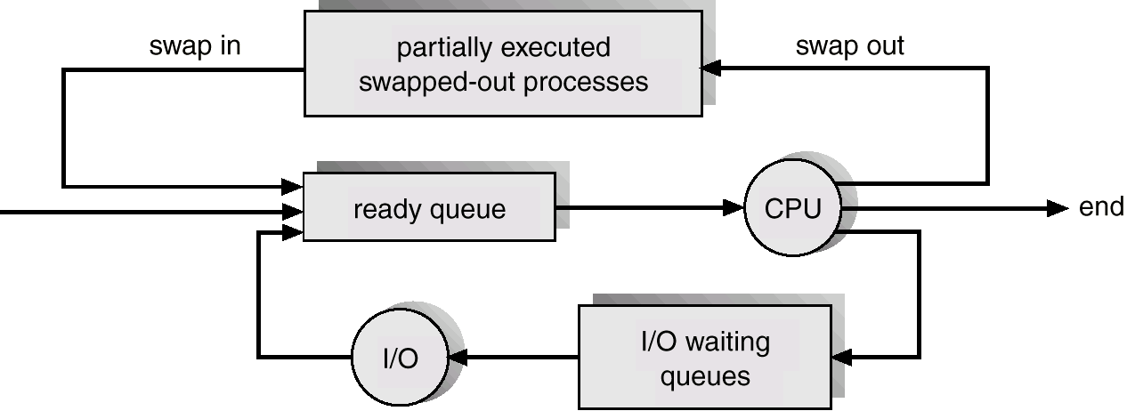
Addition of Medium Term Scheduling

Slide 24
Schedulers (Cont.)
Short-term scheduler is invoked very frequently (milliseconds) ⇒ (must be fast).
Long-term scheduler is invoked very infrequently (seconds, minutes) ⇒ (may be slow).
The long-term scheduler controls the degree of multiprogramming.
Processes can be described as either:
I/O-bound process – spends more time doing I/O than computations, many short CPU bursts.
CPU-bound process – spends more time doing computations; few very long CPU bursts.

Slide 25
Context Switch
When CPU switches to another process, the system must save the state of the old process and load the saved state for the new process.
Context-switch time is overhead; the system does no useful work while switching.
Time dependent on hardware support.

Slide 26
Process Creation
Parent process create children processes, which, in turn create other processes, forming a tree of processes.
Resource sharing
Parent and children share all resources.
Children share subset of parent’s resources.
Parent and child share no resources.
Execution
Parent and children execute concurrently.
Parent waits until children terminate.

Slide 27
Process Creation (Cont.)
Address space
Child duplicate of parent.
Child has a program loaded into it.
UNIX examples
fork system call creates new process
exec system call used after a fork to replace the process’ memory space with a new program.

Slide 28
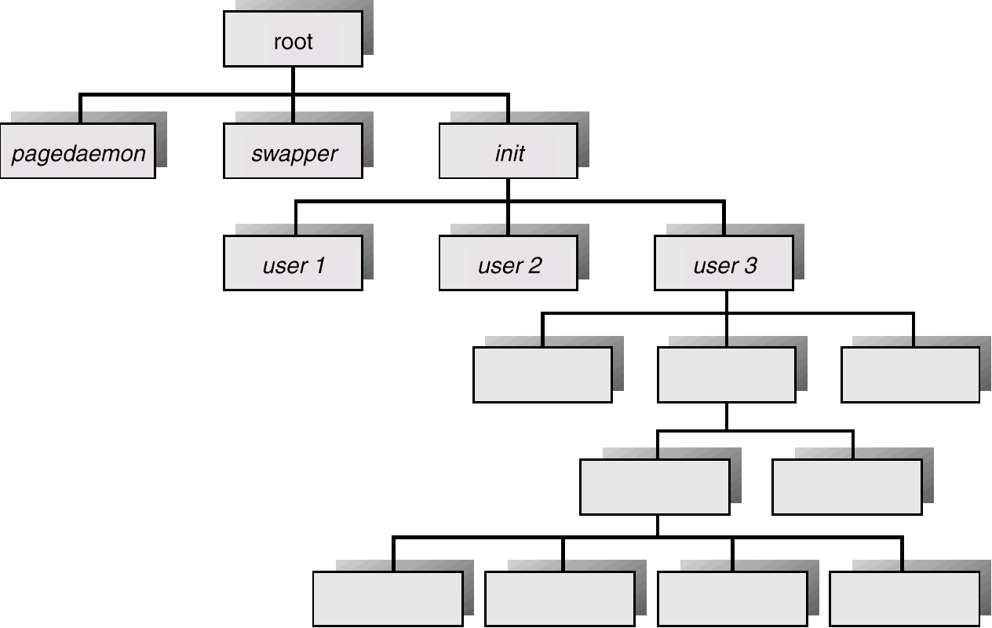
Processes Tree on a UNIX System

Slide 29
Process Termination
Process executes last statement and asks the operating system to decide it (exit).
Output data from child to parent (via wait).
Process’ resources are deallocated by operating system ( I/O files , Buffers,virtual Meory )
Parent may terminate execution of children processes (abort).
Child has exceeded allocated resources.
Task assigned to child is no longer required.
Parent is exiting.
Operating system does not allow child to continue if its parent terminates.
Cascading termination.

Slide 30
Cooperating Processes ( Concurrent )
Independent process cannot affect or be affected by the execution of another process ( Does not share any data (Temp or Persistent ))
Cooperating process can affect or be affected by the execution of another process
Advantages of process cooperation
Information sharing ( Shared files )
Computation speed-up ( CPU or I/O Channels)
Modularity
Convenience

Slide 31
Producer-Consumer Problem
Paradigm for cooperating processes, producer process produces information that is consumed by a consumer process.
unbounded-buffer places no practical limit on the size of the buffer.
bounded-buffer assumes that there is a fixed buffer size. ( Consumer must wait if the Buffer is empty and producer must wait if the buffer is full )

Slide 32
Bounded-Buffer – Shared-Memory Solution
Shared data
#define BUFFER_SIZE 10
Typedef struct {
. . .
} item;
item buffer[BUFFER_SIZE];
int in = 0;
int out = 0;
Solution is correct, but can only use BUFFER_SIZE-1 elements

Slide 33
Bounded-Buffer – Producer Process
item nextProduced;
while (1) {
while (((in + 1) % BUFFER_SIZE) == out) //Buffer full
; /* do nothing */
buffer[in] = nextProduced;
in = (in + 1) % BUFFER_SIZE;
}

Slide 34
Bounded-Buffer – Consumer Process
item nextConsumed;
while (1) {
while (in == out) // Empty
; /* do nothing */
nextConsumed = buffer[out];
out = (out + 1) % BUFFER_SIZE;
}

Slide 35
Interprocess Communication (IPC)
Mechanism for processes to communicate and to synchronize their actions.
Message system – processes communicate with each other without resorting to shared variables.
IPC facility provides two operations:
send(message) – message size fixed or variable
receive(message)
If P and Q wish to communicate, they need to:
establish a communication link between them
exchange messages via send/receive
Implementation of communication link
physical (e.g., shared memory, hardware bus)
logical (e.g., logical properties)

Slide 36
Implementation Questions
How are links established?
Can a link be associated with more than two processes?
How many links can there be between every pair of communicating processes?
What is the capacity of a link?
Is the size of a message that the link can accommodate fixed or variable?
Is a link unidirectional or bi-directional?

Slide 37
Addressing
Sending process need to be able to specify which process should receive the message
Direct addressing
Indirect Addressing
Notes:
it is necessary to have a way of specifying in the send primitive which process is to receive the message.
Similarly, most implementations allow a receiving process to indicate the source of a message to be received.
37

Slide 38
Direct Communication
Send primitive includes a specific identifier of the destination process
Receive primitive could know ahead of time which process a message is expected
Receive primitive could use source parameter to return a value when the receive operation has been performed

Slide 39
Direct Communication…
Processes must name each other explicitly:
send (P, message) – send a message to process P
receive(Q, message) – receive a message from process Q
Properties of communication link
Links are established automatically.
A link is associated with exactly one pair of communicating processes.
Between each pair there exists exactly one link.
The link may be unidirectional, but is usually bi-directional.

Slide 40
Indirect Communication
Messages are directed and received from mailboxes (also referred to as ports).
Each mailbox has a unique id.
Processes can communicate only if they share a mailbox.
Properties of communication link
Link established only if processes share a common mailbox
A link may be associated with many processes.
Each pair of processes may share several communication links.
Link may be unidirectional or bi-directional.

Slide 41
Indirect Communication
Operations
create a new mailbox
send and receive messages through mailbox
destroy a mailbox
Primitives are defined as:
send(A, message) – send a message to mailbox A
receive(A, message) – receive a message from mailbox A

Slide 42
Indirect Communication
Mailbox sharing
P₁, P₂, and P₃ share mailbox A.
P₁, sends; P₂ and P₃ receive.
Who gets the message?
Solutions
Allow a link to be associated with at most two processes.
Allow only one process at a time to execute a receive operation.
Allow the system to select arbitrarily the receiver ( either p2 or p3 ). Sender is notified who the receiver was.

Slide 43
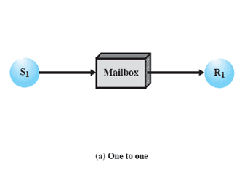
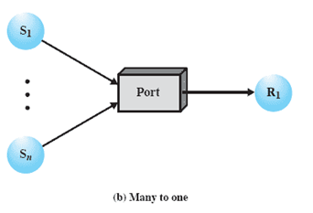
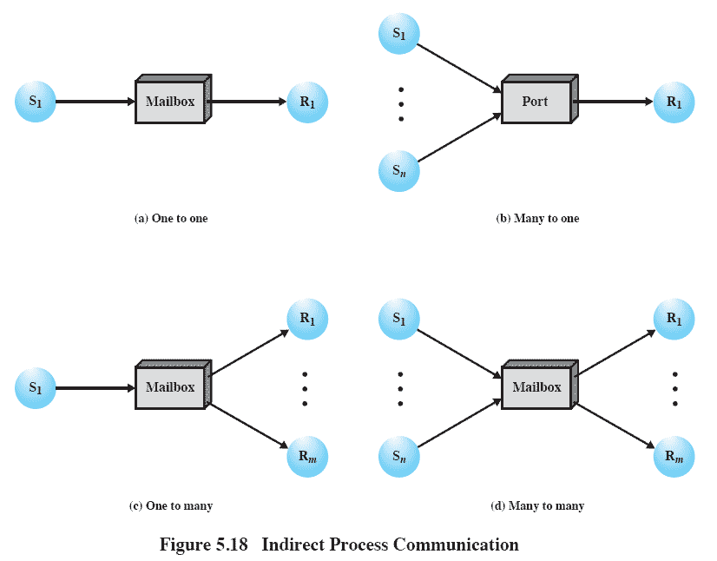
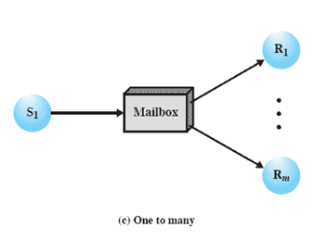
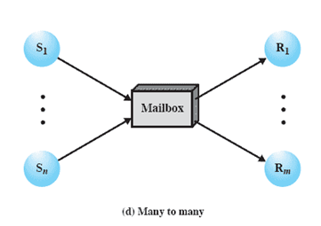
Indirect Process Communication
Notes:
Animated Slide – each item below is magnified for instructor to address separately
1) A one-to-one relationship
allows a private communications link to be set up between two processes.
This insulates their interaction from erroneous interference from other processes.
2) A many-to-one relationship is useful for client/server interaction;
one process provides service to a number of other processes.
In this case, the mailbox is often referred to as a port.
3) A one-to-many relationship allows for one sender and multiple receivers;
it is useful for applications where a message or some information is to be broadcast to a set of processes.
4) A many-to-many relationship
allows multiple server processes to provide concurrent service to multiple clients.
The association of processes to mailboxes can be either static or dynamic.
Ports are often statically associated with a particular process; that is, the port is created and assigned to the process permanently.
Similarly, a one-to-one relationship is typically defined statically and permanently. When there are many senders, the association of a sender to a mailbox may occur dynamically. Primitives such as connect and disconnect may be used for this purpose
43

Slide 44
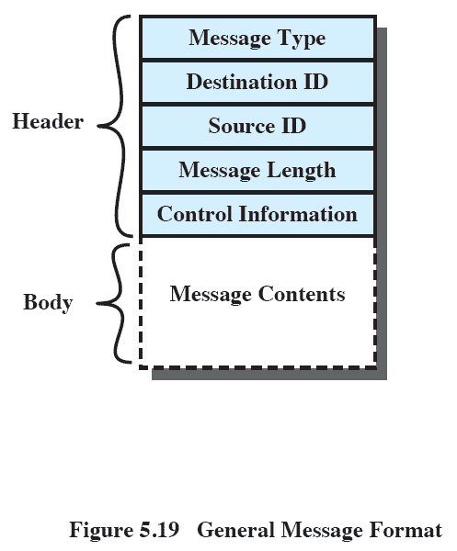
General Message Format
Notes:
The format of the message depends on the objectives of the messaging facility and whether the facility runs on a single computer or on a distributed system.
This is a typical message format for operating systems that support variable-length messages.
The message is divided into two parts:
a header, which contains information about the message.
The header may contain an identification of the source and intended destination of the message, a length field, and a type field to discriminate among various types of messages.
additional control information, e.g. pointer field so a linked list of messages can be created; a sequence number, to keep track of the number and order of messages passed between source and destination; and a priority field.
a body, which contains the actual contents of the message.
44

Slide 45
Synchronization
Message passing may be either blocking or non-blocking.
Blocking is considered synchronous
Non-blocking is considered asynchronous
send and receive primitives may be either blocking or non-blocking.

Slide 46
Synchronization conti…
Blocking Send: the sending process is blocked until the message is received by the receiving process or by mailbox.
Non blocking Send: the sending process sends the message and resumes the operation.
Blocking receive: the receiver blocks until a message is available.
Non blocking receive: the receiver retrieves either a valid message or Null.

Slide 47
Buffering
Queue of messages attached to the link; implemented in one of three ways.
1. Zero capacity – 0 messages Sender must wait for receiver (rendezvous).
2. Bounded capacity – finite length of n messages Sender must wait if link full.
3. Unbounded capacity – infinite length Sender never waits.

Slide 48
Client-Server Communication
Sockets
Remote Procedure Calls
Remote Method Invocation (Java)

Slide 49
Sockets
A socket is defined as an endpoint for communication.
Concatenation of IP address and port
The socket 161.25.19.8:1625 refers to port 1625 on host 161.25.19.8
Communication consists between a pair of sockets.

Slide 50
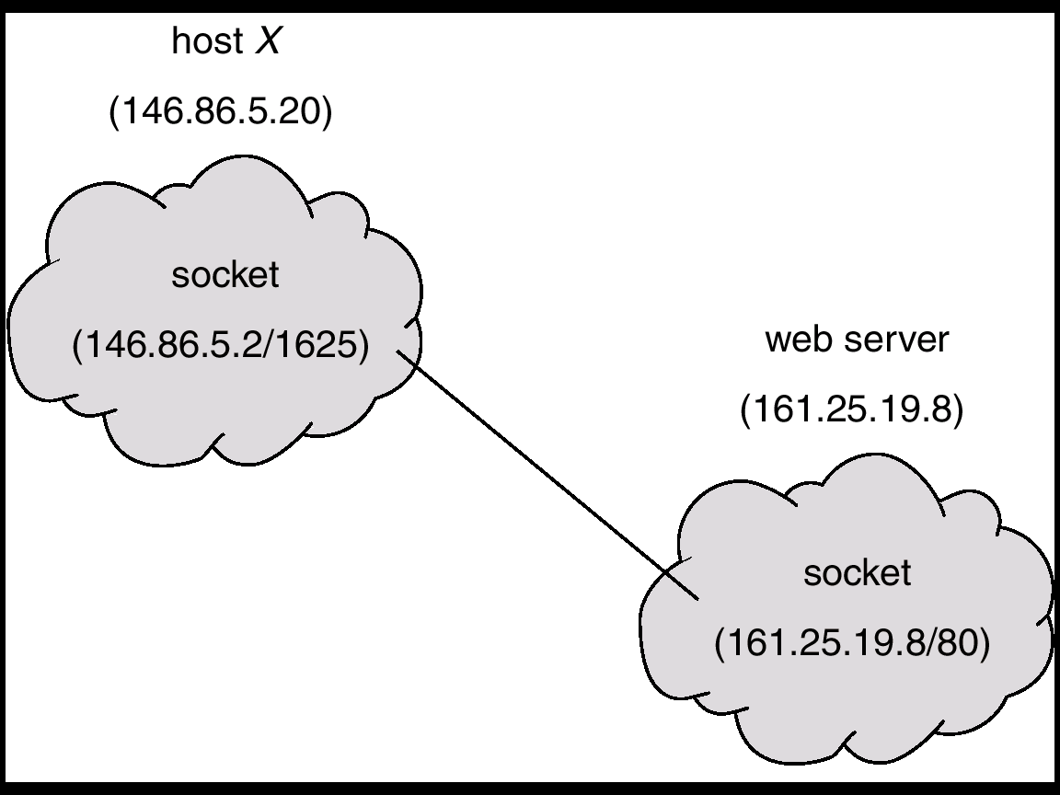
Socket Communication

Slide 51
Remote Procedure Calls
Remote procedure call (RPC) abstracts procedure calls between processes on networked systems.
Stubs – client-side proxy for the actual procedure on the server.
The client-side stub locates the server and marshalls the parameters.
The server-side stub receives this message, unpacks the marshalled parameters, and peforms the procedure on the server.

Slide 52
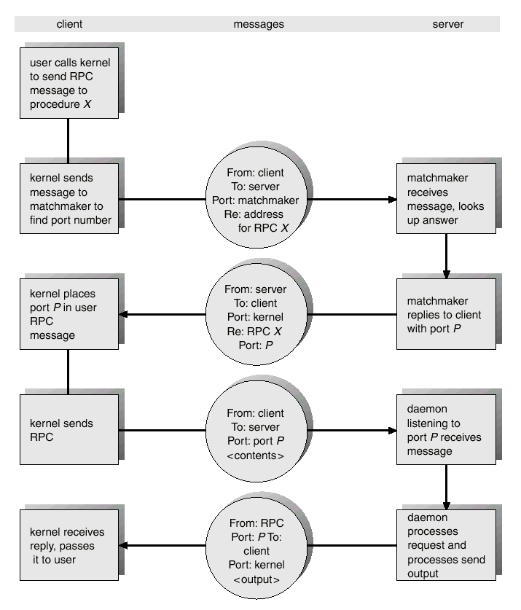
Execution of RPC

Slide 53
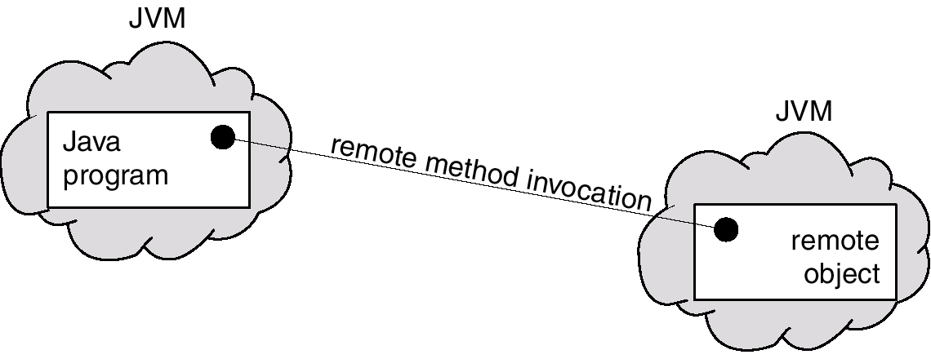
Remote Method Invocation
Remote Method Invocation (RMI) is a Java mechanism similar to RPCs.
RMI allows a Java program on one machine to invoke a method on a remote object.

Slide 54
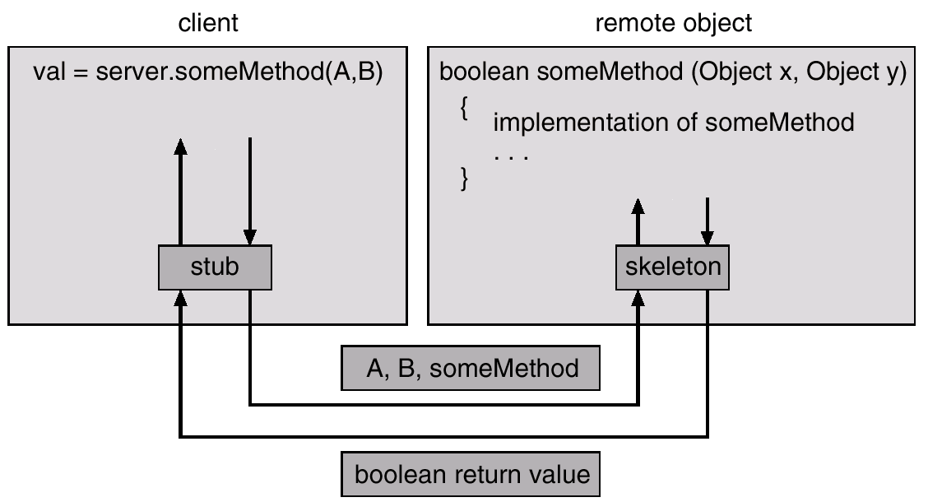
Marshalling Parameters

Slide 55
Processes and Threads
The unit of dispatching is referred to as a thread or lightweight process
The unit of resource ownership is referred to as a process or task

Slide 56
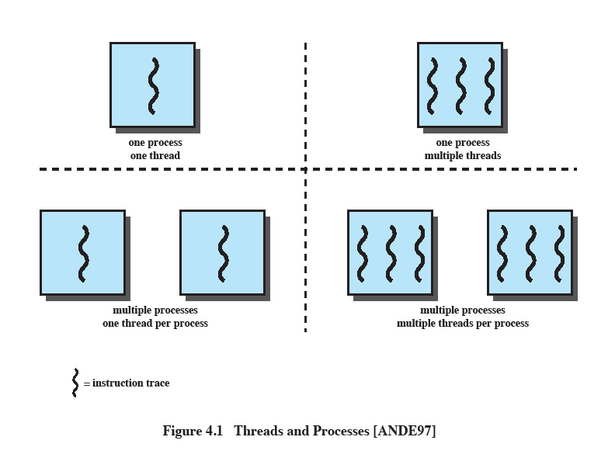
Multithreading
The ability of an OS to support multiple, concurrent paths of execution within a single process.
Notes:
Multithreading refers to the ability of an OS to support multiple, concurrent paths of execution within a single process.
56

Slide 57
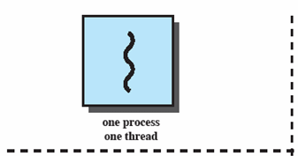
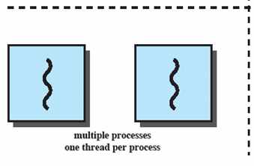
Single Thread Approaches
MS-DOS supports a single user process and a single thread.
Some UNIX, support multiple user processes but only support one thread per process
Notes:
Animated Slide
Onload Enlarges top-left to discuss DOS
Click1: Enlarges bottom-left for Unix
Single Threaded approach: The traditional approach of a single thread of execution per process, in which the concept of a thread is not recognized, examples are
MS DOS (single process, single thread)
Unix (multiple, single threaded processes)
57

Slide 58

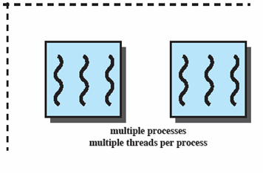
Multithreading
Java run-time environment is a single process with multiple threads
Multiple processes and threads are found in Windows, Solaris, and many modern versions of UNIX
Notes:
Animated Slide
Onload: Emphasis on top-right and JRE (single process, multiple thread),
Click 1: Emphasis on multiple processes with multiple threads – this is the main topic of this chapter
JRE is an example of a system of one process with multiple threads.
Of main interest in this chapter is the use of multiple processes, each of which support multiple threads.
Examples include:
Windows,
Solaris,
and many modern versions of UNIX.
58

Slide 59
One or More Threads in Process
Each thread has
An execution state (running, ready, etc.)
Saved thread context when not running
An execution stack
Some per-thread static storage for local variables
Access to the memory and resources of its process (all threads of a process share this)
Notes:
Within a process, there may be one or more threads, each with the following:
• A thread execution state (Running, Ready, etc.).
• A saved thread context when not running;
one way to view a thread is as an independent program counter operating within a process.
59

Slide 60
Threads and processes
Takes less time to create a new thread than a process
Less time to terminate a thread than a process
Switching between two threads takes less time that switching processes
Threads can communicate with each other
without invoking the kernel
Notes:
If there is an application or function that should be implemented as a set of related units of execution,
it is far more efficient to do so as a collection of threads - rather than a collection of separate processes.
60

Slide 61
Threads
Several actions that affect all of the threads in a process
The OS must manage these at the process level.
Examples:
Suspending a process involves suspending all threads of the process
Termination of a process, terminates all threads within the process
Notes:
Suspension involves swapping the address space of one process out of main memory to make room for the address space of another process.
Because all threads in a process share the same address space, all threads are suspended at the same time.
Similarly, termination of a process terminates all threads within that process.
61

Slide 62
Activities similar to Processes
Threads have execution states and may synchronize with one another.
Similar to processes
We look at these two aspects of thread functionality in turn.
States
Synchronisation
Notes:
62

Slide 63
Thread Execution States
States associated with a change in thread state
Spawn (another thread)
Block
Issue: will blocking a thread block other, or all, threads
Unblock
Finish (thread)
Deallocate register context and stacks
Notes:
A significant issue is whether the blocking of a thread results in the blocking of the entire process.
If one thread in a process is blocked, does this prevent the running of any other thread in the same process even if that other thread is in a ready state?
Clearly, some of the flexibility and power of threads is lost if the one blocked thread blocks an entire process.
63

Slide 64
One view…
One way to view a thread is as an independent program counter operating within a process.

Slide 65
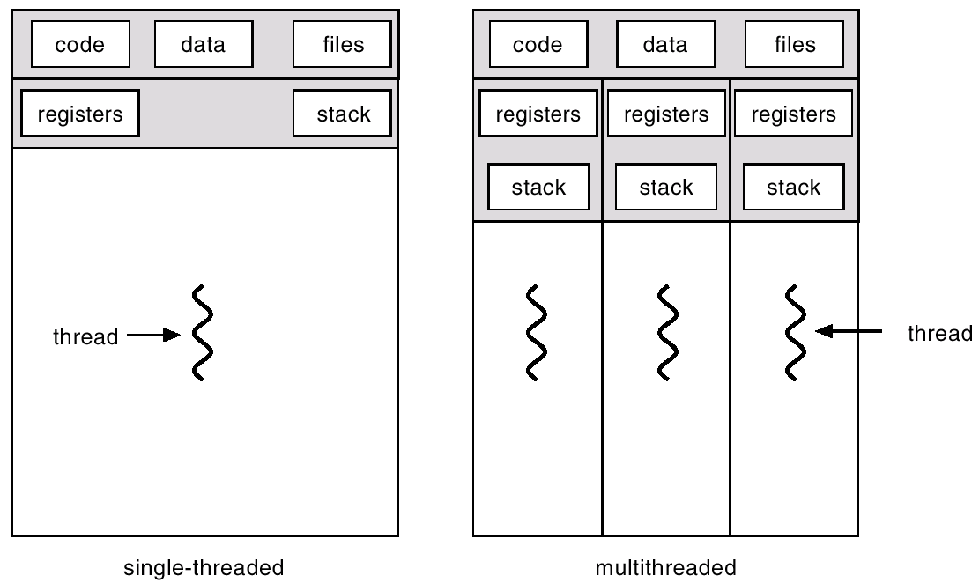
Single and Multithreaded Processes

Slide 66
Benefits
Responsiveness
Foreground and background work
Resource Sharing
Economy
Utilization of MP Architectures

Slide 67
User levelThreads
Thread management done by user-level threads library.
Library supports thread creation and destroying ,scheduling and Management with no support from kernel.
User level thread are fast to create and manage .
Examples
- POSIX Pthreads
- Mach C-threads
- Solaris threads

Slide 68
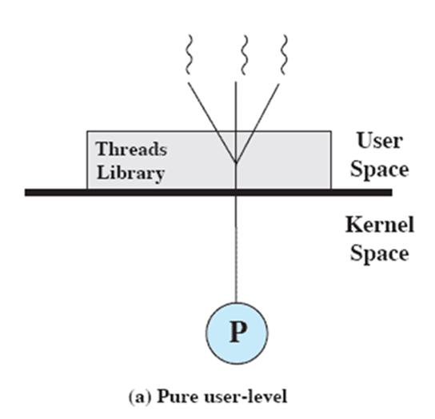
User-Level Threads
All thread management is done by the application
The kernel is not aware of the existence of threads
Notes:
68

Slide 69
Kernel Level Threads ( OS )
Supported by the Kernel.
slower to create and manage.
Examples
- Windows 95/98/NT/2000
- Solaris
- Tru64 UNIX
- BeOS
- Linux

Slide 70
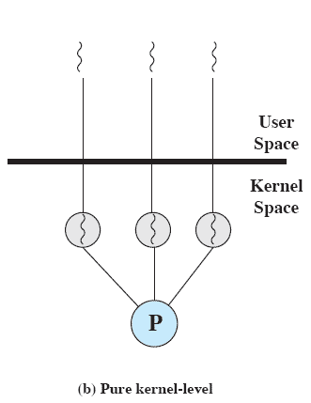
Kernel-Level Threads
Kernel maintains context information for the process and the threads
No thread management done by application
Scheduling is done on a thread basis
Notes:
The kernel maintains context information for the process as a whole and for individual threads within the process.
Scheduling by the kernel is done on a thread basis.
-
70

Slide 71
Advantages of KLT
The kernel can simultaneously schedule multiple threads from the same process on multiple processors.
If one thread in a process is blocked, the kernel can schedule another thread of the same process.
Kernel routines themselves can be multithreaded.

Slide 72
Disadvantage of KLT
The transfer of control from one thread to another within the same process requires a mode switch to the kernel

Slide 73
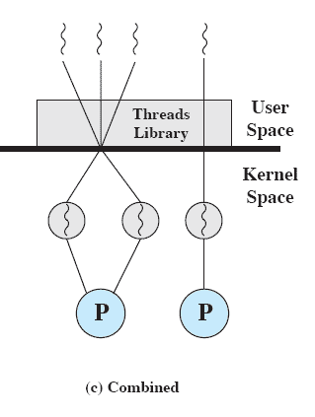
Combined Approaches
Thread creation done in the user space
Bulk of scheduling and synchronization of threads by the application
Example is Solaris
Notes:
In a combined approach, multiple threads within the same application can run in parallel on multiple processors,
and a blocking system call need not block the entire process.
If properly designed, this approach should combine the advantages of the pure ULT and KLT approaches while minimizing the disadvantages.
73

Slide 74
Multithreading Models
Many-to-One
One-to-One
Many-to-Many

Slide 75
Many-to-One
Many user-level threads mapped to single kernel thread.
Used on systems that do not support kernel threads.
Efficient but the entire process will block if a thread makes a blocking system call .

Slide 76
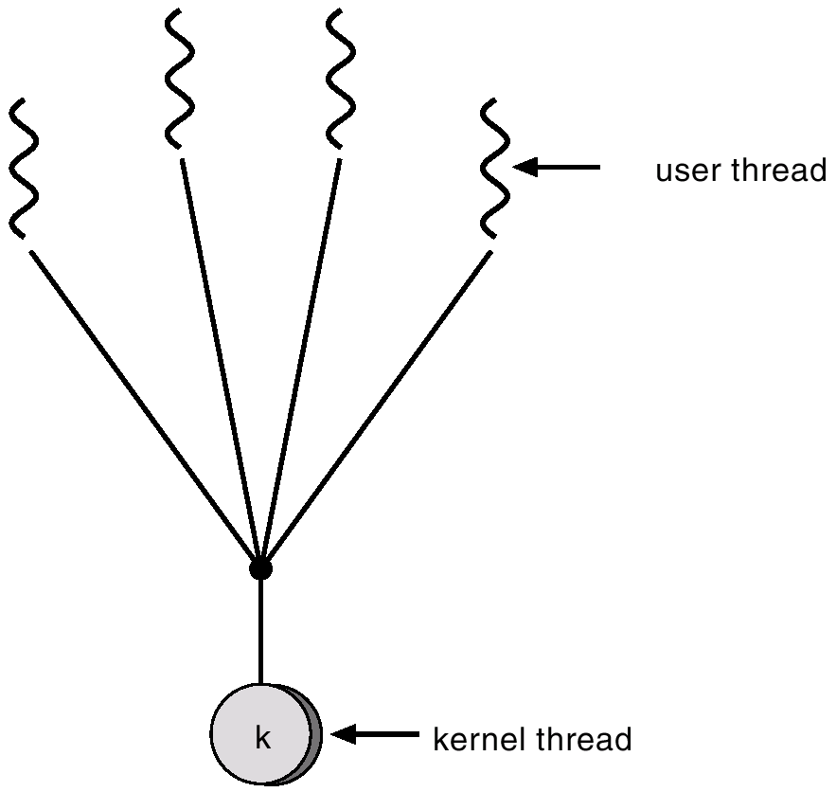
Many-to-One Model

Slide 77
One-to-One
Each user-level thread maps to kernel thread.
provides more concurrent than previous case.
Drawback:
creating a user thread requires creating the corresponding kernel thread ( Overhead )
Examples
- Windows 95/98/NT/2000
- OS/2

Slide 78
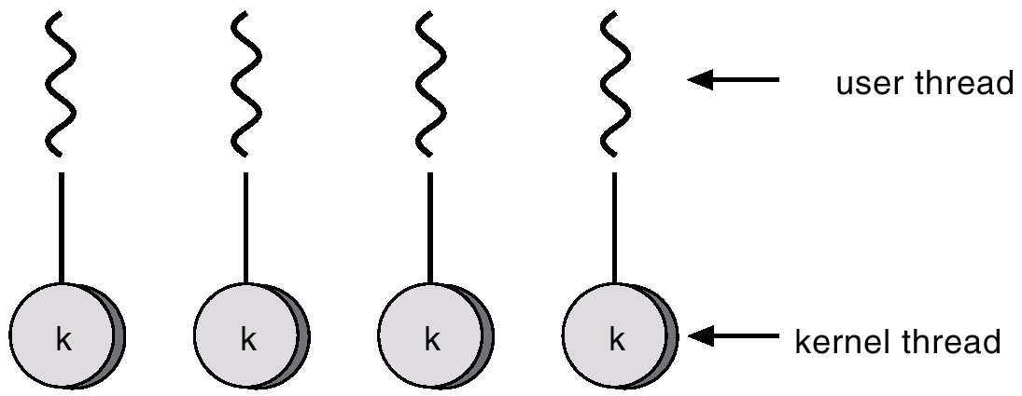
One-to-one Model

Slide 79
Many-to-Many Model
Allows many user level threads to be mapped to many kernel threads.
Allows the operating system to create a sufficient number of kernel threads.
Solaris 2,IRIX,HP-UX and Tru64 Unix
Windows NT/2000 with the ThreadFiber package

Slide 80
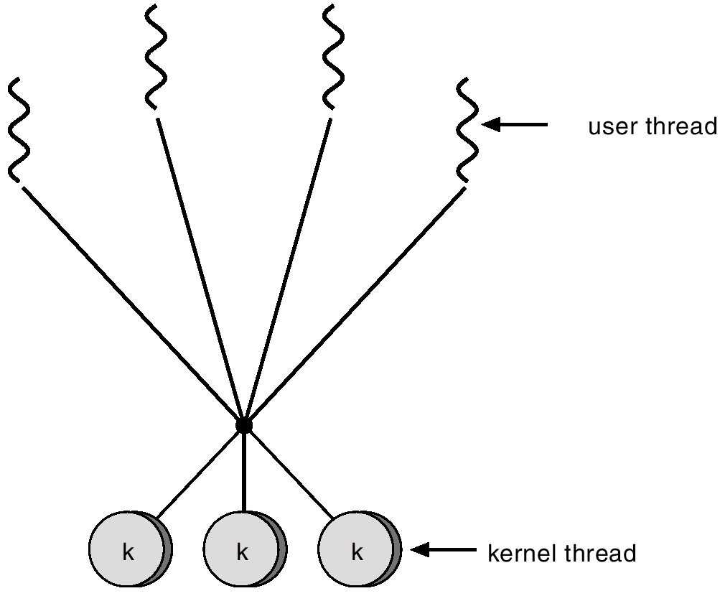
Many-to-Many Model

Slide 81
Client and server with threads
Thread 2 makes
requests to server
Input-output
Receipt &
queuing
Thread 1
generates
results
T1
Requests
N threads
Client
Server
Notes:
81

Slide 82
Threading Issues
Semantics of fork() and exec() system calls.
Thread cancellation.
Signal handling
Thread pools
Thread specific data

Slide 83
Pthreads
a POSIX standard (IEEE 1003.1c) API for thread creation and synchronization.
API specifies behavior of the thread library, implementation is up to development of the library.
Common in UNIX operating systems.

Slide 84
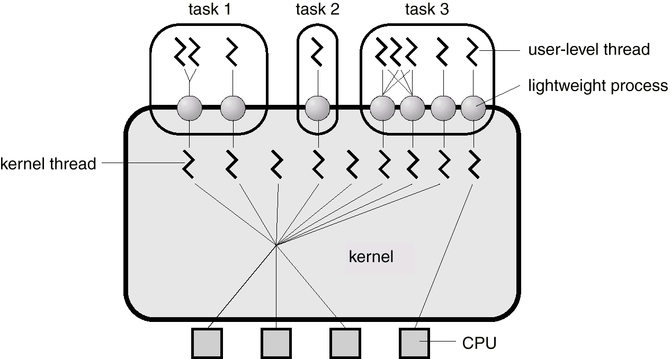
Solaris 2 Threads

Slide 85
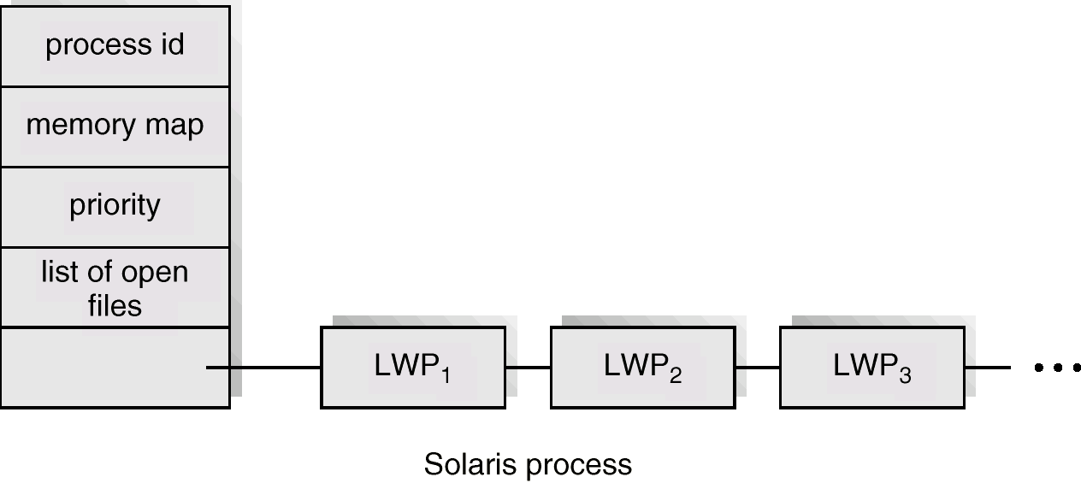
Solaris Process

Slide 86
Windows 2000 Threads
Implements the one-to-one mapping.
Each thread contains
- a thread id
- register set
- separate user and kernel stacks
- private data storage area

Slide 87
Linux Threads
Linux refers to them as tasks rather than threads.
Thread creation is done through clone() system call.
Clone() allows a child task to share the address space of the parent task (process)

Slide 88
Java Threads
Java threads may be created by:
Extending Thread class
Implementing the Runnable interface
Java threads are managed by the JVM.

Slide 89
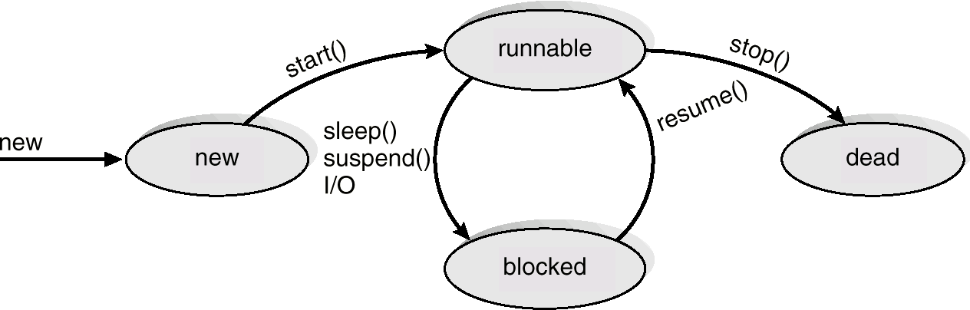
Java Thread States

Slide 90
Basic Concepts
Maximum CPU utilization obtained with multiprogramming
CPU–I/O Burst Cycle – Process execution consists of a cycle of CPU execution and I/O wait.
CPU burst distribution

Slide 91
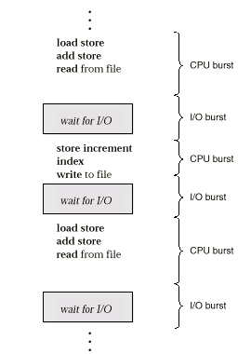
Alternating Sequence of CPU And I/O Bursts

Slide 92
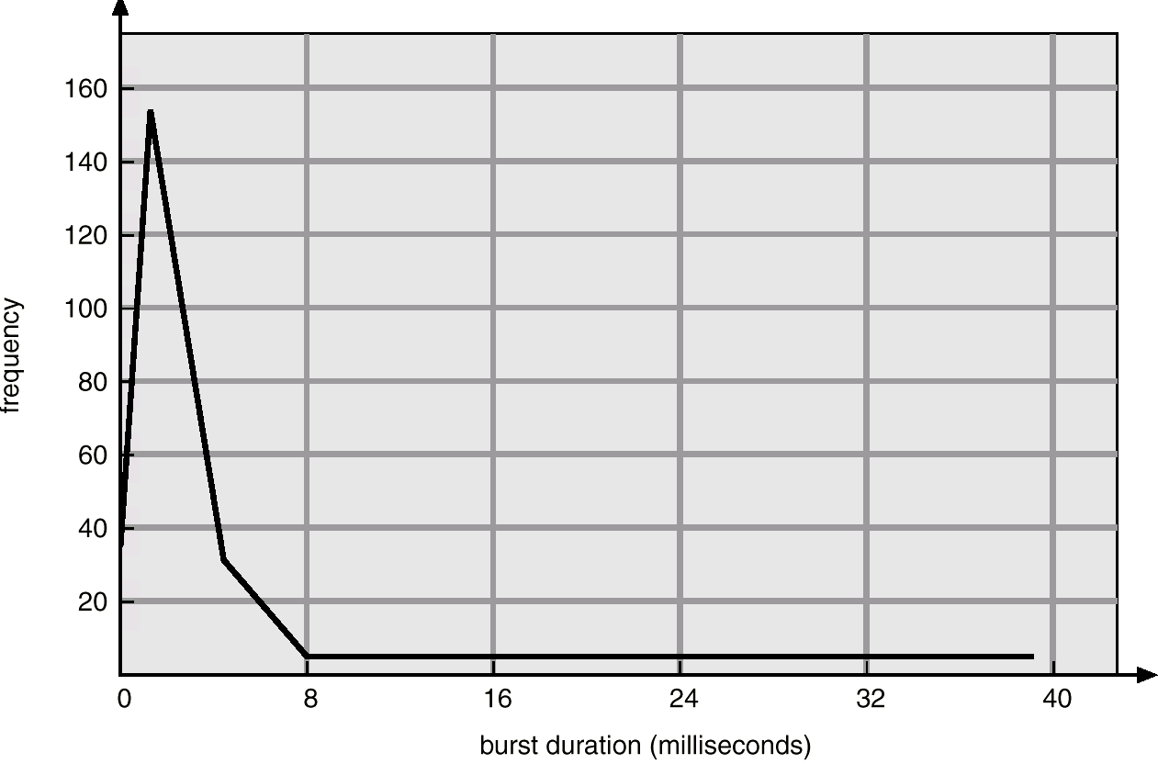
Histogram of CPU-burst Times

Slide 93
CPU Scheduler
Selects from among the processes in memory that are ready to execute, and allocates the CPU to one of them.
CPU scheduling decisions may take place when a process:
1. Switches from running to waiting state.
2. Switches from running to ready state.
3. Switches from waiting to ready.
4. Terminates.
Scheduling under 1 and 4 is nonpreemptive.
All other scheduling is preemptive.

Slide 94
Dispatcher
Dispatcher module gives control of the CPU to the process selected by the short-term scheduler; this involves:
switching context
switching to user mode
jumping to the proper location in the user program to restart that program
Dispatch latency – time it takes for the dispatcher to stop one process and start another running.

Slide 95
Scheduling Criteria
CPU utilization – keep the CPU as busy as possible
Throughput – # of processes that complete their execution per time unit.
=> Depends on the length of process
Turnaround time – amount of time to execute a particular process

Slide 96
Turn around Time =
Time to get into Memory
+
Waiting time in ready queue
+
Executing time in CPU
+
Wait time in waiting queue for I/O

Slide 97
Waiting time – amount of time a process has been waiting in the ready queue
Response time – amount of time it takes from when a request was submitted until the first response is produced, not output (for time-sharing environment)

Slide 98
Optimization Criteria
Max CPU utilization
Max throughput
Min turnaround time
Min waiting time
Min response time

Slide 99
First-Come, First-Served (FCFS) Scheduling
Process Burst Time
P₁ 24
P₂ 3
P₃ 3
Suppose that the processes arrive in the order: P₁ , P₂ , P₃ The Gantt Chart for the schedule is:
Waiting time for P₁ = 0; P₂ = 24; P₃ = 27
Average waiting time: (0 + 24 + 27)/3 = 17
P₁
P₂
P₃
0
24
27
30

Slide 100
FCFS Scheduling (Cont.)
Suppose that the processes arrive in the order
P₂ , P₃ , P₁ .
The Gantt chart for the schedule is:
Waiting time for P₁ = 6; P₂ = 0; P₃ = 3
Average waiting time: (6 + 0 + 3)/3 = 3
Much better than previous case.
Convoy effect short process behind long process
P₂
P₃
P₁
0
3
6
30

Slide 101
EXAMPLE - 1
Arrival Time
Process
CPU Time (or) Burst Time
0
0
0
0
P1
P2
P3
P4
5
10
8
3
Time required by CPU to execute job
P1
P2
P3
P4
0
5
15
23
26
Gantt Chart

Slide 102
Average Waiting Time:
Waiting Time = Starting Time – Arrival Time
P1 => 0 – 0 = 0
P2 => 5 – 0 = 5
P3 => 15 – 0 = 15
P4 => 23 – 0 = 23
Average waiting Time = 0 + 5 + 15 + 23 / 4
= 43 / 4
=> 10.75ms

Slide 103
Average Turn Around Time:
Turn around time = Finished Time – Arrival Time
P1 = 5 – 0 = 5
P2 = 15 – 0 = 15
P3 = 23 – 0 = 23
P4 = 26 – 0 = 26
Average Turn around Time = 5 + 15 + 23 + 26 / 4
= 69 / 4
=> 17.25ms

Slide 104
Average Response Time:
Response Time = First response – arrival Time
P1 => 0 – 0 = 0
P2 => 5 – 0 = 5
P3 => 15 – 0 = 15
P4 => 23 – 0 = 23
Average Response Time = 0 + 5 + 15 + 23 / 4
= 43 / 4
=> 10.75ms

Slide 105
Average Waiting Time = 10.75
Average Turn around Time = 17.25
Average Response Time = 10.75
Cons:
High Turn around & Waiting time
Low rate of CPU utilization { Bcs of non-preemption}
Short job have to wait for long time, when the CPU is allocate to long
jobs

Slide 106
EXAMPLE - 2
Arrival Time
Process
CPU Time (or) Burst Time
0
2
4
6
8
P1
P2
P3
P4
P5
3
6
4
5
2
P1
P2
P3
P4
P5
0
3
9
13
18
20
Gantt Chart

Slide 107
Shortest-Job-First (SJR) Scheduling
Associate with each process the length of its next CPU burst. Use these lengths to schedule the process with the shortest time.
Two schemes:
nonpreemptive – once CPU given to the process it cannot be preempted until completes its CPU burst.
preemptive – if a new process arrives with CPU burst length less than remaining time of current executing process, preempt. This scheme is know as the Shortest-Remaining-Time-First (SRTF).
SJF is optimal – gives minimum average waiting time for a given set of processes.

Slide 108
EXAMPLE - 1
Arrival Time
Process
CPU Time (or) Burst Time
0
0
0
0
P1
P2
P3
P4
5
10
8
3
Shortest CPU time
P4
P1
P3
P2
0
3
8
16
26
Gantt Chart

Slide 109
Average Waiting Time:
Waiting Time = Starting Time – Arrival Time
P1 => 0 – 0 = 0
P2 => 3 – 0 = 3
P3 => 8 – 0 = 8
P4 => 16 – 0 = 16
Average waiting Time = 0 + 3 + 8 + 16 / 4
= 27 / 4
=> 6.75 ms

Slide 110
Average Turn Around Time:
Turn around time = Finished Time – Arrival Time
P1 = 3 – 0 = 3
P2 = 8 – 0 = 8
P3 = 16 – 0 = 16
P4 = 26 – 0 = 26
Average Turn around Time = 3 + 8 + 16 + 26 / 4
= 53 / 4
=> 13.25ms

Slide 111
Average Waiting Time = 6.75
Average Turn around Time = 13.25
Pros:
Moves a shorter process for execution before a longer process
Having Least Average waiting time and Turn around time
Cons:
The real difficulty of the SJF algorithm is knowing the length of the next cpu Burst.( Request)

Slide 112
Shortest Job First Scheduling
Example: Process Arrival Time Burst Time
P₁ 0 7
P₂ 2 4
P₃ 4 1
P₄ 5 4
Non preemptive SJF
Average waiting time = (0 + 6 + 3 + 7)/4 = 4
P₁
P₃
P₂
P₄
0
2
4
5
7
8
12
16
P₁‘s wating time = 0
P₂‘s wating time = 6
P₃‘s wating time = 3
P₄‘s wating time = 7
P₁(7)
P₂(4)
P₃(1)
P₄(4)

Slide 113
Shortest Remaining Time First [SRTF]
Policy => Preemptive Scheduling
Scheduler compare the remaining time of executing process & new process
Scheduler always selects the process that has Shortest Remaining Time

Slide 114
EXAMPLE 1: (preemptive)
Process Name Arrival Time Service Time
1 | 0 | 8
2 | 1 | 4
3 | 2 | 9
4 | 3 | 5

Slide 115
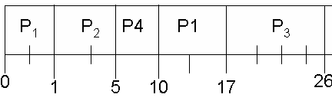
Example 1 Conti….
Avg Waiting time (( 10-1)+(1-1)+(17-2)+(5-3))/4=6.5

Slide 116
Preemptive SJF
Process Arrival Time Burst Time
P₁ 0.0 7
P₂ 2.0 4
P₃ 4.0 1
P₄ 5.0 4
SJF (preemptive)
Average waiting time = (9 + 1 + 0 +2)/4 - 3
P₁
P₂
P₃
P₂
P₄
P₁
0
2
4
5
7
11
16

Slide 117
EXAMPLE - 3
Arrival Time
Process
CPU Time (or) Burst Time
3
6
4
5
2
0
2
4
6
8
P1
P2
P3
P4
P5
P1
P2
P3
P5
P2
P4
0
3
4
8
10
15
20
Gantt Chart

Slide 118
Determining Length of Next CPU Burst
Can only estimate the length.
Can be done by using the length of previous CPU bursts, using exponential averaging.

Slide 119
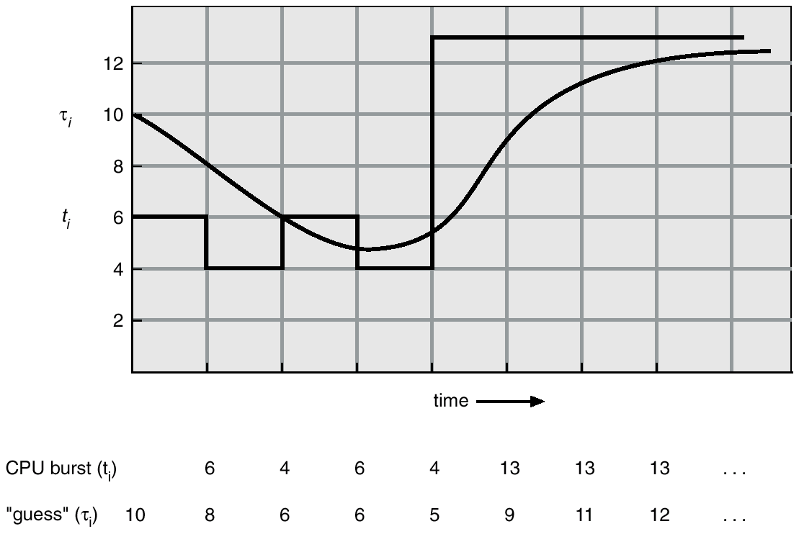
Prediction of the Length of the Next CPU Burst

Slide 120
Examples of Exponential Averaging
α =0
τ_{n+1} = τ_{n}
Recent history does not count.
α =1
τ_{n+1} = t_{n}
Only the actual last CPU burst counts.
If we expand the formula, we get:
τ_{n+1} = α t_{n}+(1 - α) α t_{n} -1 + …
+(1 - α )^{j} α t_{n} -1 + …
+(1 - α )^{n=1} t_{n} τ₀
Since both α and (1 - α) are less than or equal to 1, each successive term has less weight than its predecessor.

Slide 121
Priority Scheduling
A priority number (integer) is associated with each process
The CPU is allocated to the process with the highest priority (smallest integer ≡ highest priority).
Preemptive
nonpreemptive
SJF is a priority scheduling where priority is the predicted next CPU burst time.
Problem ≡ Starvation – low priority processes may never execute.
Solution ≡ Aging – as time progresses increase the priority of the process.

Slide 122
Priority Scheduling
Priority is associated with each process
Scheduler always picks up the highest priority process for execution from
Ready Queue
Priority scheduling can be either :
=> Preemptive
If newly arrived process have higher priority than running process >> Preempt the CPU
=> Non Preemptive
Put the new process in Ready Queue

Slide 123
EXAMPLE
Priority
Process
CPU Time (or) Burst Time
3
2
4
1
P1
P2
P3
P4
5
10
8
3
P4
P2
P1
P3
0
3
13
18
26
Gantt Chart

Slide 124
Round Robin (RR)
Each process gets a small unit of CPU time (time quantum), usually 10-100 milliseconds. After this time has elapsed, the process is preempted and added to the end of the ready queue.
If there are n processes in the ready queue and the time quantum is q, then each process gets 1/n of the CPU time in chunks of at most q time units at once. No process waits more than (n-1)q time units.
Performance
q large ⇒ FIFO
q small ⇒ q must be large with respect to context switch, otherwise overhead is too high.

Slide 125
EXAMPLE 1
Process
CPU Time (or) Burst Time
P1
P2
P3
24
3
3
Time Quantum = 4 ms
P1
P2
P3
P1
P1
P1
P1
P1
0
4
7
10
14
18
22
26
30
Gantt Chart

Slide 126
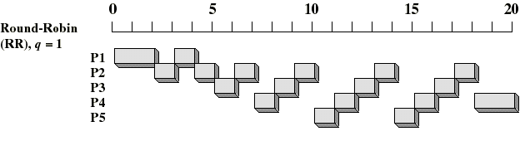
Example 2:
Arrival
Time
Service
Time
Process
1
0
3
2
2
6
3
4
4
4
6
5
5
8
2

Slide 127
Example 3 of RR with Time Quantum = 20
Process Burst Time
P₁ 53
P₂ 17
P₃ 68
P₄ 24
The Gantt chart is:
Typically, higher average turnaround than SJF, but better response.
P₁
P₂
P₃
P₄
P₁
P₃
P₄
P₁
P₃
P₃
0
20
37
57
77
97
117
121
134
154
162

Slide 128
Multilevel Queue
Ready queue is partitioned into separate queues: foreground (interactive) background (batch)
Each queue has its own scheduling algorithm, foreground – RR background – FCFS
Scheduling must be done between the queues.
Fixed priority scheduling; (i.e., serve all from foreground then from background). Possibility of starvation.
Time slice – each queue gets a certain amount of CPU time which it can schedule amongst its processes; i.e., 80% to foreground in RR
20% to background in FCFS

Slide 129
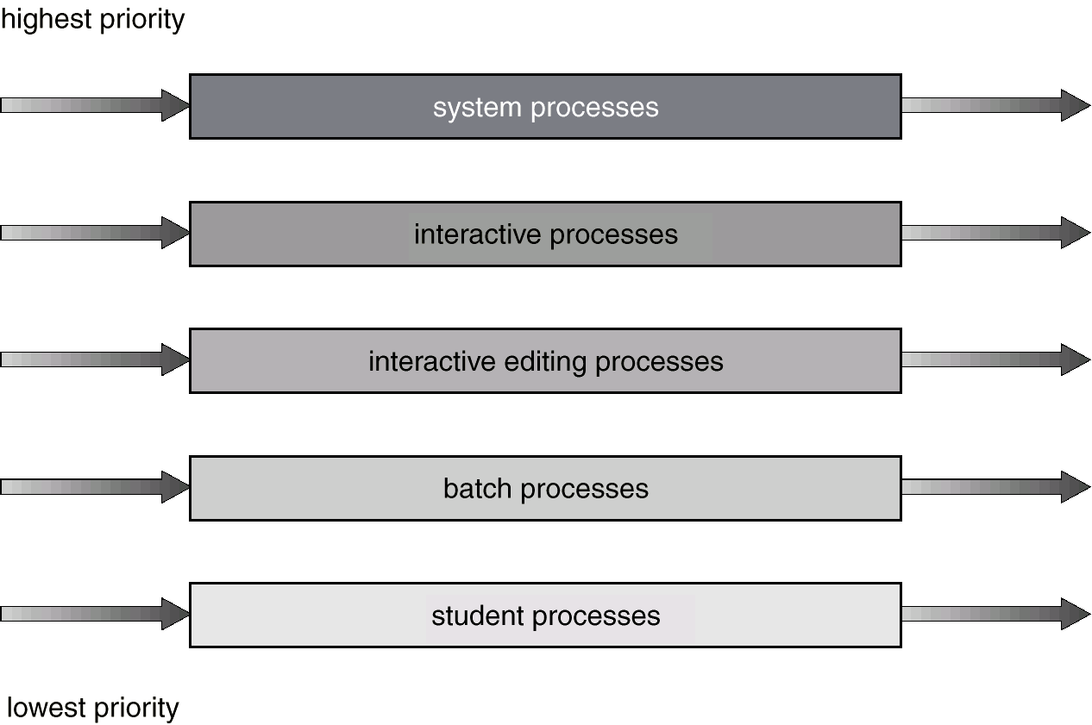
Multilevel Queue Scheduling

Slide 130
Multilevel Feedback Queue
A process can move between the various queues; aging can be implemented this way.
Multilevel-feedback-queue scheduler defined by the following parameters:
number of queues
scheduling algorithms for each queue
method used to determine when to upgrade a process
method used to determine when to demote a process
method used to determine which queue a process will enter when that process needs service

Slide 131
Example of Multilevel Feedback Queue
Three queues:
Q₀ – time quantum 8 milliseconds
Q₁ – time quantum 16 milliseconds
Q₂ – FCFS
Scheduling
A new job enters queue Q₀ which is served FCFS. When it gains CPU, job receives 8 milliseconds. If it does not finish in 8 milliseconds, job is moved to queue Q₁.
At Q₁ job is again served FCFS and receives 16 additional milliseconds. If it still does not complete, it is preempted and moved to queue Q₂.

Slide 132
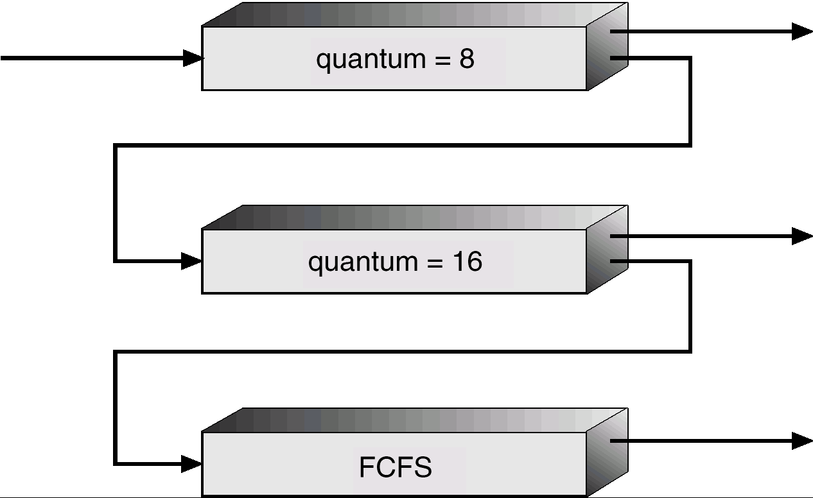
Multilevel Feedback Queues

Slide 133
Multiple-Processor Scheduling
CPU scheduling more complex when multiple CPUs are available.
Homogeneous processors within a multiprocessor.
Load sharing
Asymmetric multiprocessing – only one processor accesses the system data structures, alleviating the need for data sharing.

Slide 134
Real-Time Scheduling
Hard real-time systems – required to complete a critical task within a guaranteed amount of time.
Soft real-time computing – requires that critical processes receive priority over less fortunate ones.

Slide 135
Process Synchronization
Background
The Critical-Section Problem
Synchronization Hardware
Semaphores
Classical Problems of Synchronization
Critical Regions
Monitors

Slide 136
Background
Concurrent access to shared data may result in data inconsistency.
Maintaining data consistency requires mechanisms to ensure the orderly execution of cooperating processes.
Shared-memory solution to bounded-buffer problem allows at most n – 1 items in buffer at the same time. A solution, where all N buffers are used is not simple.
Suppose that we modify the producer-consumer code by adding a variable counter, initialized to 0 and incremented each time a new item is added to the buffer

Slide 137
Bounded-Buffer
Shared data
#define BUFFER_SIZE 10
typedef struct {
. . .
} item;
item buffer[BUFFER_SIZE];
int in = 0;
int out = 0;
int counter = 0;

Slide 138
Bounded-Buffer
Producer process
item nextProduced;
while (1) {
while (counter == BUFFER_SIZE)
; /* do nothing */
buffer[in] = nextProduced;
in = (in + 1) % BUFFER_SIZE;
counter++;
}

Slide 139
Bounded-Buffer
Consumer process
item nextConsumed;
while (1) {
while (counter == 0)
; /* do nothing */
nextConsumed = buffer[out];
out = (out + 1) % BUFFER_SIZE;
counter--;
}

Slide 140
Bounded Buffer
The statements counter++; counter--; must be performed atomically.
Atomic operation means an operation that completes in its entirety without interruption.

Slide 141
Bounded Buffer
The statement “count++” may be implemented in machine language as: register1 = counter
register1 = register1 + 1 counter = register1
The statement “count--” may be implemented as: register2 = counter register2 = register2 – 1 counter = register2

Slide 142
Bounded Buffer
If both the producer and consumer attempt to update the buffer concurrently, the assembly language statements may get interleaved.
Interleaving depends upon how the producer and consumer processes are scheduled.

Slide 143
Bounded Buffer
Assume counter is initially 5. One interleaving of statements is: producer: register1 = counter (register1 = 5) producer: register1 = register1 + 1 (register1 = 6) consumer: register2 = counter (register2 = 5) consumer: register2 = register2 – 1 (register2 = 4) producer: counter = register1 (counter = 6) consumer: counter = register2 (counter = 4)
The value of count may be either 4 or 6, where the correct result should be 5.

Slide 144
Race Condition
Race condition: The situation where several processes access – and manipulate shared data concurrently. The final value of the shared data depends upon which process finishes last.
To prevent race conditions, concurrent processes must be synchronized.

Slide 145
The Critical-Section Problem
n processes all competing to use some shared data
Each process has a code segment, called critical section, in which the shared data is accessed.
Problem – ensure that when one process is executing in its critical section, no other process is allowed to execute in its critical section.

Slide 146
Solution to Critical-Section Problem
1. Mutual Exclusion. If process P_{i} is executing in its critical section, then no other processes can be executing in their critical sections.
2. Progress. If no process is executing in its critical section and there exist some processes that wish to enter their critical section, then the selection of the processes that will enter the critical section next cannot be postponed indefinitely.
3. Bounded Waiting. A bound must exist on the number of times that other processes are allowed to enter their critical sections after a process has made a request to enter its critical section and before that request is granted.
Assume that each process executes at a nonzero speed
No assumption concerning relative speed of the n processes.

Slide 147
Initial Attempts to Solve Problem
Only 2 processes, P₀ and P₁
General structure of process P_{i} (other process P_{j})
do {
entry section
critical section
exit section
reminder section
} while (1);
Processes may share some common variables to synchronize their actions.

Slide 148
Algorithm 1
Shared variables:
int turn; initially turn = 0
turn - i ⇒ P_{i} can enter its critical section
Process P_{i}
do {
while (turn != i) ;/* Do Skip */
critical section
turn = j;
reminder section
} while (1);
Satisfies mutual exclusion, but not progress

Slide 149
Algorithm 2
Shared variables
boolean flag[2]; initially flag [0] = flag [1] = false.
flag [i] = true ⇒ P_{i} ready to enter its critical section
Process P_{i}
do {
flag[i] := true; while (flag[j]) ; critical section
flag [i] = false;
remainder section
} while (1);
Satisfies mutual exclusion, but not progress requirement.

Slide 150
Algorithm 3 (Peterson’s)
Combined shared variables of algorithms 1 and 2.
Process P_{i}
do {
flag [i]:= true; turn = j; while (flag [j] && turn = j) ;
critical section
flag [i] = false;
remainder section
} while (1);
Meets all three requirements; solves the critical-section problem for two processes.

Slide 151
Bakery Algorithm
Critical section for n processes
Before entering its critical section, process receives a number. Holder of the smallest number enters the critical section.
If processes P_{i} and P_{j} receive the same number, if i < j, then P_{i} is served first; else P_{j} is served first.
The numbering scheme always generates numbers in increasing order of enumeration; i.e., 1,2,3,3,3,3,4,5...
Applications:
Bakeries, Ice-cream stores, Deli counters and Motor-Registries etc:

Slide 152
Bakery Algorithm
Notation <≡ lexicographical order (ticket #, process id #)
(a,b) < c,d) if a < c or if a = c and b < d
max (a₀,…, a_{n-1}) is a number, k, such that k ≥ a_{i} for i - 0, …, n – 1
Shared data
boolean choosing[n];
int number[n];
Data structures are initialized to false and 0 respectively

Slide 153
Bakery Algorithm
do {
choosing[i] = true;
number[i] = max(number[0], number[1], …, number [n – 1])+1;
choosing[i] = false;
for (j = 0; j < n; j++) {
while (choosing[j]) ;
while ((number[j] != 0) && (number[j,j] < number[i,i])) ;
}
critical section
number[i] = 0;
remainder section
} while (1);

Slide 154
Synchronization Hardware
Test and modify the content of a word atomically .
boolean TestAndSet(boolean &target) {
boolean rv = target;
target = true;
return rv;
}

Slide 155
Mutual Exclusion with Test-and-Set
Shared data: boolean lock = false;
Process P_{i}
do {
while (TestAndSet(lock)) ;
critical section
lock = false;
remainder section
}

Slide 156
Synchronization Hardware
Atomically swap two variables.
void Swap(boolean &a, boolean &b) {
boolean temp = a;
a = b;
b = temp;
}

Slide 157
Mutual Exclusion with Swap
Shared data (initialized to false): boolean lock;
boolean waiting[n];
Process P_{i}
do {
key = true;
while (key == true)
Swap(lock,key);
critical section
lock = false;
remainder section
}

Slide 158
Hardware Mutual Exclusion: Advantages
Applicable to any number of processes on either a single processor or multiple processors sharing main memory
It is simple and therefore easy to verify
It can be used to support multiple critical sections
Notes:
158

Slide 159
Hardware Mutual Exclusion: Disadvantages
Busy-waiting consumes processor time
Starvation is possible when a process leaves a critical section and more than one process is waiting.
Some process could indefinitely be denied access.
Deadlock is possible
Notes:
Busy waiting
While a process is waiting for access to a critical section, it continues to consume processor time.
Starvation is possible.
When a process leaves a critical section and more than one process is waiting, the selection of a waiting process is arbitrary.
Thus, some process could indefinitely be denied access.
Deadlock is possible.
Example (on a uniprocessor).
Process P1 executes the special instruction (e.g., compare&swap, exchange) and enters its critical section.
P1 is then interrupted to give the processor to P2, which has higher priority.
If P2 now attempts to use the same resource as P1, it will be denied access because of the mutual exclusion mechanism.
Thus it will go into a busy waiting loop.
However, P1 will never be dispatched because it is of lower priority than another ready process, P2.
159

Slide 160
Semaphores
Synchronization tool that does not require busy waiting.
Semaphore S – integer variable
can only be accessed via two indivisible (atomic) operations
P: wait (S):
while S≤ 0 do no-op; S--;
V: signal (S):
S++;

Slide 161
Semaphore
Fundamental principle of this design mechanism:
Two or more processes can cooperate by means of simple signals, such that a process can be forced to stop at a specified place until it has received a specific signal.
Notes:
Complex coordination between processes can be satisfied by building a correct structure of such signals. For signalling, special values called SEMAPHORES are used.
161

Slide 162
Semaphore
Semaphore:
An integer value used for signalling among processes.
Only three operations may be performed on a semaphore, all of which are atomic:
initialize,
Decrement (semWait)
increment. (semSignal)
Notes:
1. A semaphore may be initialized to a nonnegative integer value.
2. The semWait operation decrements the semaphore value.
If the value becomes negative, then the process executing the semWait is blocked.
Otherwise, the process continues execution.
3. The semSignal operation increments the semaphore value.
If the resulting value is less than or equal to zero, then a process blocked by a semWait operation, if any, is unblocked.
162

Slide 163
Critical Section of n Processes
Shared data:
semaphore mutex; //initially mutex = 1
Process Pi: do { wait(mutex); //wait (S):
//P:while S≤ 0 do no-op // S--;
critical section
signal(mutex);
V: signal (S):
//S++;
remainder section } while (1
problem for real multiprogramming systems ( Due to busy waiting )

Slide 164
Semaphore Implementation( To avoid Busy waiting Problem)
Define a semaphore as a record
typedef struct {
int value; struct process *L; } semaphore;
Assume two simple operations:
block suspends the process that invokes it.
wakeup(P) resumes the execution of a blocked process P.

Slide 165
Implementation ( To avoid Busy waiting Problem)
Semaphore operations now defined as
wait(S): S.value--;
if (S.value < 0) {
add this process to S.L; block;
}
signal(S): S.value++;
if (S.value <= 0) {
remove a process P from S.L; wakeup(P);
}

Slide 166
Semaphore as a General Synchronization Tool
Execute B in P_{j} only after A executed in P_{i}
Use semaphore flag initialized to 0
Code:
P_{i} P_{j}
 
A wait(flag)
signal(flag) B

Slide 167
Deadlock and Starvation
Deadlock – two or more processes are waiting indefinitely for an event that can be caused by only one of the waiting processes.
Let S and Q be two semaphores initialized to 1
P₀ P₁
wait(S); wait(Q);
wait(Q); wait(S);
 
signal(S); signal(Q);
signal(Q) signal(S);
Starvation – indefinite blocking. A process may never be removed from the semaphore queue in which it is suspended.

Slide 168
Two Types of Semaphores
Counting semaphore – integer value can range over an unrestricted domain.
Binary semaphore – integer value can range only between 0 and 1; can be simpler to implement.
Can implement a counting semaphore S as a binary semaphore.

Slide 169
Implementing S as a Binary Semaphore
Data structures:
binary-semaphore S1, S2;
int C:
Initialization:
S1 = 1
S2 = 0
C = initial value of semaphore S

Slide 170
Implementing S
wait operation
wait(S1);
C--;
if (C < 0) {
signal(S1);
wait(S2);
}
signal(S1);
signal operation
wait(S1);
C ++;
if (C <= 0)
signal(S2);
else
signal(S1);

Slide 171
Classical Problems of Synchronization
Bounded-Buffer Problem
Readers and Writers Problem
Dining-Philosophers Problem

Slide 172
Bounded-Buffer Problem
Shared data semaphore full, empty, mutex; Initially: full = 0, empty = n, mutex = 1

Slide 173
Bounded-Buffer Problem Producer Process
do {
…
produce an item in nextp
…
wait(empty);
wait(mutex);
…
add nextp to buffer
…
signal(mutex);
signal(full);
} while (1);

Slide 174
Bounded-Buffer Problem Consumer Process
do {
wait(full)
wait(mutex);
…
remove an item from buffer to nextc
…
signal(mutex);
signal(empty);
…
consume the item in nextc
…
} while (1);

Slide 175
Readers-Writers Problem
S hared data semaphore mutex, wrt; Initially mutex = 1, wrt = 1, readcount = 0

Slide 176
Readers-Writers Problem Writer Process
wait(wrt);
…
writing is performed
…
signal(wrt);

Slide 177
Readers-Writers Problem Reader Process
wait(mutex);
readcount++;
if (readcount == 1)
wait(wrt);
signal(mutex);
…
reading is performed
…
wait(mutex);
readcount--;
if (readcount == 0)
signal(wrt);
signal(mutex):

Slide 178
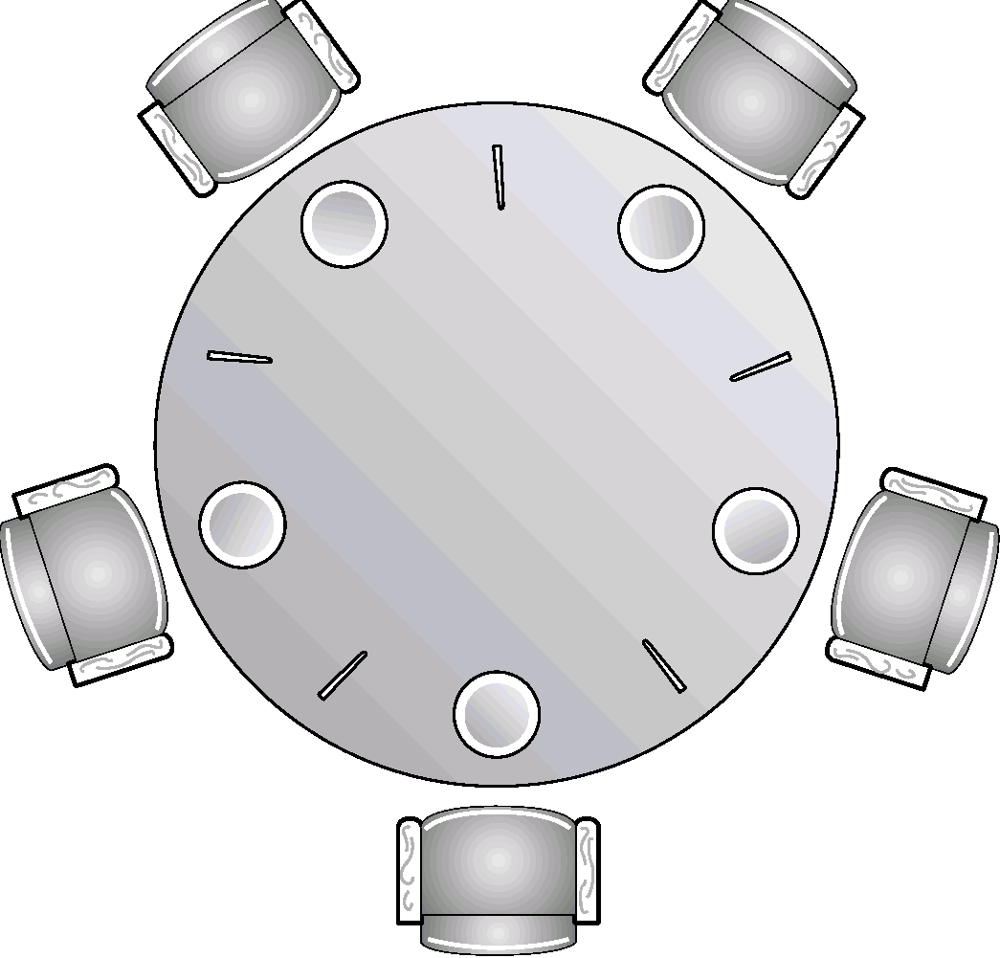
Dining-Philosophers Problem
Shared data
semaphore chopstick[5];
Initially all values are 1

Slide 179
Dining Philosopher’s Problem (Dijkstra ’71)

Slide 180

Dining Philosophers…
Philosophers eat/think
Eating needs 2 forks
Pick one fork at a time
How to prevent deadlock

Slide 181
Dining-Philosophers Problem
Philosopher i:
do {
wait(chopstick[i])
wait(chopstick[(i+1) % 5])
…
eat
…
signal(chopstick[i]);
signal(chopstick[(i+1) % 5]);
…
think
…
} while (1);

Slide 182
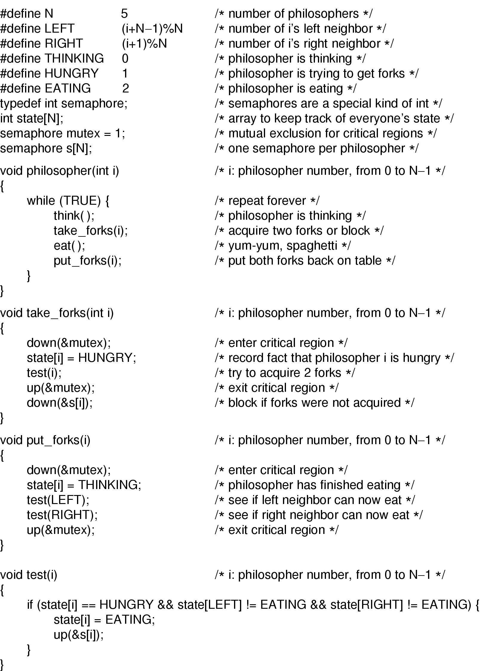
Dining Philosophers
Solution to dining philosophers problem (part 1)

Slide 183
Dining Philosophers
Solution to dining philosophers problem (part 2)

Slide 184
Critical Regions
High-level synchronization construct
A shared variable v of type T, is declared as:
v: shared T
Variable v accessed only inside statement
region v when B do S where B is a boolean expression.
While statement S is being executed, no other process can access variable v.

Slide 185
Critical Regions
Regions referring to the same shared variable exclude each other in time.
When a process tries to execute the region statement, the Boolean expression B is evaluated. If B is true, statement S is executed. If it is false, the process is delayed until B becomes true and no other process is in the region associated with v.

Slide 186
Example – Bounded Buffer
Shared data:
struct buffer {
int pool[n];
int count, in, out;
}

Slide 187
Bounded Buffer Producer Process
Producer process inserts nextp into the shared buffer
region buffer when( count < n) { pool[in] = nextp; in:= (in+1) % n; count++; }

Slide 188
Bounded Buffer Consumer Process
Consumer process removes an item from the shared buffer and puts it in nextc
region buffer when (count > 0) { nextc = pool[out]; out = (out+1) % n; count--; }

Slide 189
Implementation region x when B do S
Associate with the shared variable x, the following variables:
semaphore mutex, first-delay, second-delay; int first-count, second-count;
Mutually exclusive access to the critical section is provided by mutex.
If a process cannot enter the critical section because the Boolean expression B is false, it initially waits on the first-delay semaphore; moved to the second-delay semaphore before it is allowed to reevaluate B.

Slide 190
Implementation
Keep track of the number of processes waiting on first-delay and second-delay, with first-count and second-count respectively.
The algorithm assumes a FIFO ordering in the queuing of processes for a semaphore.
For an arbitrary queuing discipline, a more complicated implementation is required.

Slide 191
Monitors
High-level synchronization construct that allows the safe sharing of an abstract data type among concurrent processes.
monitor monitor-name
{
shared variable declarations
procedure body P1 (…) {
. . .
}
procedure body P2 (…) {
. . .
}
procedure body Pn (…) {
. . .
}
{
initialization code
}
}

Slide 192
Monitors
To allow a process to wait within the monitor, a condition variable must be declared, as
condition x, y;
Condition variable can only be used with the operations wait and signal.
The operation
x.wait(); means that the process invoking this operation is suspended until another process invokes
x.signal();
The x.signal operation resumes exactly one suspended process. If no process is suspended, then the signal operation has no effect.

Slide 193
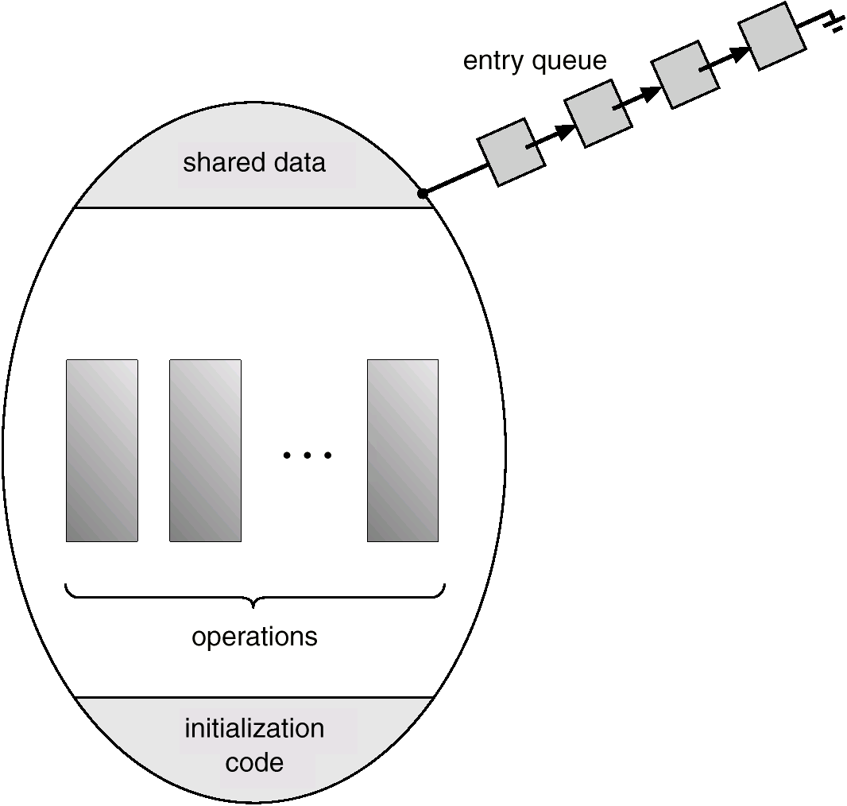
Schematic View of a Monitor

Slide 194
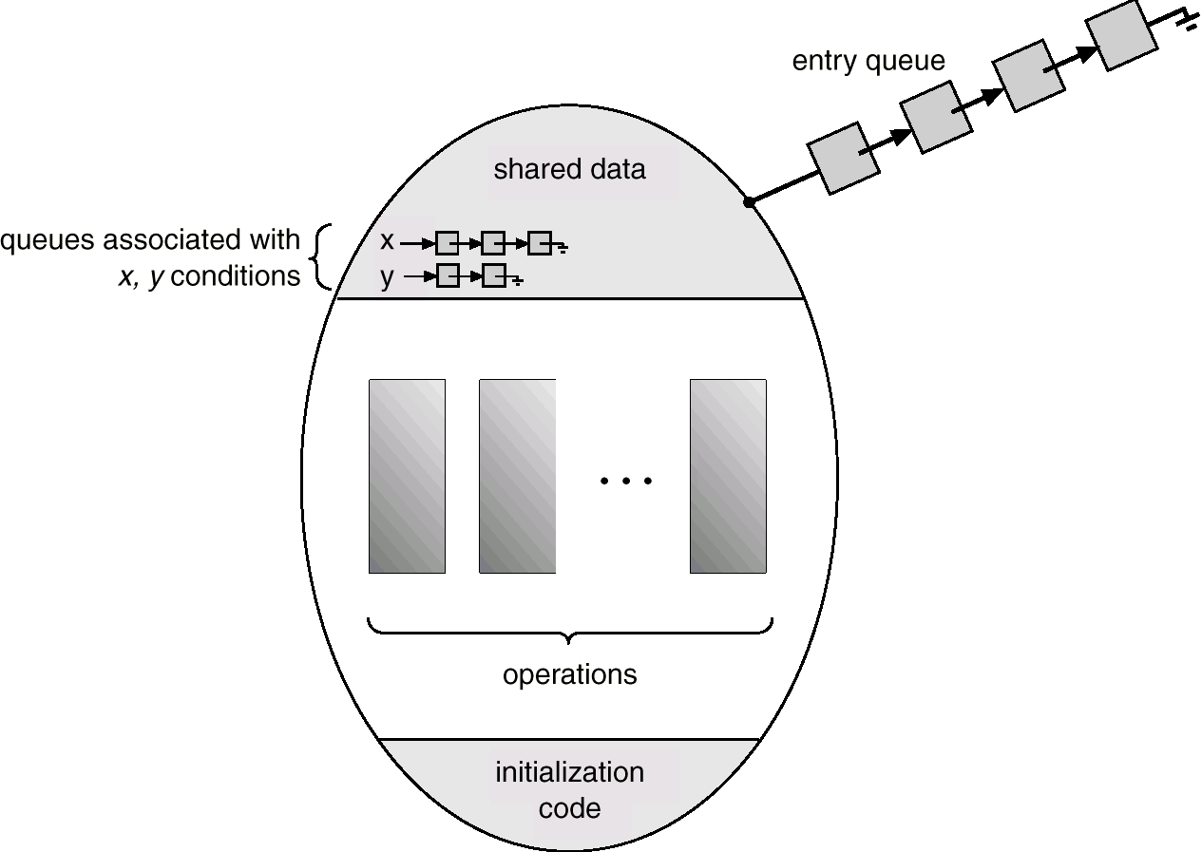
Monitor With Condition Variables

Slide 195
Dining Philosophers Example
monitor dp
{
enum {thinking, hungry, eating} state[5];
condition self[5];
void pickup(int i) // following slides
void putdown(int i) // following slides
void test(int i) // following slides
void init() {
for (int i = 0; i < 5; i++)
state[i] = thinking;
}
}

Slide 196
Dining Philosophers
void pickup(int i) {
state[i] = hungry;
test[i];
if (state[i] != eating)
self[i].wait();
}
void putdown(int i) {
state[i] = thinking;
// test left and right neighbors
test((i+4) % 5);
test((i+1) % 5);
}

Slide 197
Dining Philosophers
void test(int i) {
if ( (state[(I + 4) % 5] != eating) &&
(state[i] == hungry) &&
(state[(i + 1) % 5] != eating)) {
state[i] = eating;
self[i].signal();
}
}

Slide 198
Monitor Implementation Using Semaphores
Variables
semaphore mutex; // (initially = 1)
semaphore next; // (initially = 0)
int next-count = 0;
Each external procedure F will be replaced by
wait(mutex);
…
body of F;
…
if (next-count > 0)
signal(next)
else
signal(mutex);
Mutual exclusion within a monitor is ensured.

Slide 199
Monitor Implementation
For each condition variable x, we have:
semaphore x-sem; // (initially = 0)
int x-count = 0;
The operation x.wait can be implemented as:
x-count++;
if (next-count > 0)
signal(next);
else
signal(mutex);
wait(x-sem);
x-count--;

Slide 200
Monitor Implementation
The operation x.signal can be implemented as:
if (x-count > 0) {
next-count++;
signal(x-sem);
wait(next);
next-count--;
}

Slide 201
Monitor Implementation
Conditional-wait construct: x.wait(c);
c – integer expression evaluated when the wait operation is executed.
value of c (a priority number) stored with the name of the process that is suspended.
when x.signal is executed, process with smallest associated priority number is resumed next.
Check two conditions to establish correctness of system:
User processes must always make their calls on the monitor in a correct sequence.
Must ensure that an uncooperative process does not ignore the mutual-exclusion gateway provided by the monitor, and try to access the shared resource directly, without using the access protocols.

Slide 202
Deadlocks
System Model
Deadlock Characterization
Methods for Handling Deadlocks
Deadlock Prevention
Deadlock Avoidance
Deadlock Detection
Recovery from Deadlock
Combined Approach to Deadlock Handling

Slide 203
The Deadlock Problem
A set of blocked processes each holding a resource and waiting to acquire a resource held by another process in the set.
Example
System has 2 tape drives.
P₁ and P₂ each hold one tape drive and each needs another one.
Example
semaphores A and B, initialized to 1
P₀ P₁
wait (A); wait(B)
wait (B); wait(A)

Slide 204
Bridge Crossing Example
Traffic only in one direction.
Each section of a bridge can be viewed as a resource.
If a deadlock occurs, it can be resolved if one car backs up (preempt resources and rollback).
Several cars may have to be backed up if a deadlock occurs.
Starvation is possible.

Slide 205


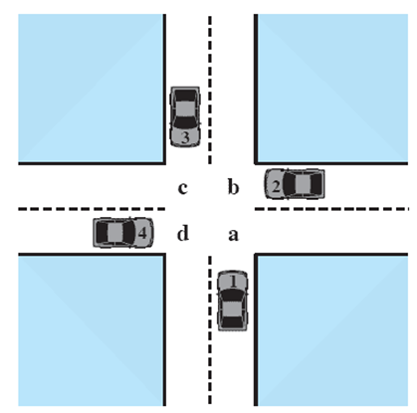



Potential Deadlock
I need quad C and B
I need quad B and C
I need quad A and B
I need quad D and A
Notes:
Animated Slide
Click 1 Cars approach intersection
Then Cars announce their resource needs
All deadlocks involve conflicting needs for resources by two or more processes. A common example is the traffic deadlock.
The typical rule of the road in the United States is that a car at a four-way stop should defer to a car immediately to its right.
This rule works if there are only two or three cars at the intersection.
If all four cars arrive at about the same time, each will refrain from entering the intersection, this causes a potential deadlock.
The deadlock is only potential, not actual, because the necessary resources are available for any of the cars to proceed.
If one car eventually does proceed, it can do so.
205

Slide 206

Actual Deadlock
HALT until D is free
HALT until C is free
HALT until B is free
HALT until A is free
Notes:
Animated Slide
Click 1 Cars move to deadlock
Then Cars announce their resource need
But if all four cars ignore the rules and proceed (cautiously) into the intersection at the same time, then each car seizes one resource (one quadrant) but cannot proceed because the required second resource has already been seized by another car.
This is an actual deadlock.
206

Slide 207
System Model
Resource types R₁, R₂, . . ., R_{m}
CPU cycles, memory space, I/O devices
Each resource type R_{i} has W_{i} instances.
Each process utilizes a resource as follows:
request
use
release

Slide 208
Resource Categories
Two general categories of resources:
Reusable
can be safely used by only one process at a time and is not depleted by that use.
Consumable
one that can be created (produced) and destroyed (consumed).

Slide 209
Reusable Resources
Such as:
Processors, I/O channels, main and secondary memory, devices, and data structures such as files, databases, and semaphores
Deadlock occurs if each process holds one resource and requests the other
Notes:
209

Slide 210
Example of Reuse Deadlock
Consider two processes that compete for exclusive access to a disk file D and a tape drive T.
Deadlock occurs if each process holds one resource and requests the other.

Slide 211
Example 2: Memory Request
Space is available for allocation of 200Kbytes, and the following sequence of events occur
Deadlock occurs if both processes progress to their second request
P1
P2
. . .
. . .
Request 80 Kbytes;
Request 70 Kbytes;
. . .
. . .
Request 80 Kbytes;
Request 60 Kbytes;
Notes:
If the amount of memory to be requested is not known ahead of time, it is difficult to deal with this type of deadlock by means of system design constraints.
The best way to deal with this particular problem is, in effect, to eliminate the possibility by using virtual memory, which is discussed later (ch 8)
211

Slide 212
Consumable Resources
Such as Interrupts, signals, messages, and information in I/O buffers
Deadlock may occur if a Receive message is blocking
May take a rare combination of events to cause deadlock
Notes:
212

Slide 213
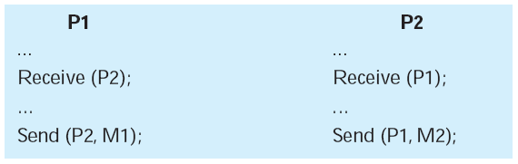
Example of Deadlock
Consider a pair of processes, in which each process attempts to receive a message from the other process and then send a message to the other process
Notes:
Deadlock occurs if the Receive is blocking (i.e., the receiving process is blocked until the message is received).
A design error is the cause of the deadlock.
Such errors may be quite subtle and difficult to detect.
Furthermore, it may take a rare combination of events to cause the deadlock; thus a program could be in use for a considerable period of time, even years, before the deadlock actually occurs.
213

Slide 214
Deadlock Characterization
Deadlock can arise if four conditions hold simultaneously.
Mutual exclusion: only one process at a time can use a resource.
Hold and wait: a process holding at least one resource is waiting to acquire additional resources held by other processes.
No preemption: a resource can be released only voluntarily by the process holding it, after that process has completed its task.
Circular wait: there exists a set {P₀, P₁, …, P₀} of waiting processes such that P₀ is waiting for a resource that is held by P₁, P₁ is waiting for a resource that is held by
P₂, …, P_{n–1} is waiting for a resource that is held by P_{n}, and P₀ is waiting for a resource that is held by P₀.

Slide 215
Resource-Allocation Graph
A set of vertices V and a set of edges E.
V is partitioned into two types:
P = {P₁, P₂, …, P_{n}}, the set consisting of all the processes in the system.
R = {R₁, R₂, …, R_{m}}, the set consisting of all resource types in the system.
request edge – directed edge P_{i} → R_{j}
assignment edge – directed edge R_{j} → P_{i}

Slide 216
Resource-Allocation Graph (Cont.)
Process
Resource Type with 4 instances
P_{i} requests instance of R_{j}
P_{i} is holding an instance of R_{j}
P_{i}
R_{j}
P_{i}
R_{j}

Slide 217
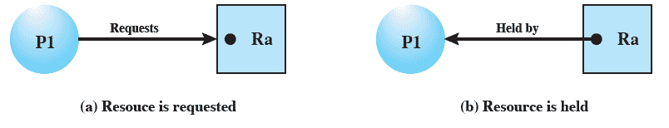
Resource Allocation Graphs
Directed graph that depicts a state of the system of resources and processes
Notes:
A graph edge directed from a process to a resource indicates a resource that has been requested by the process but not yet granted.
Within a resource node, a dot is shown for each instance of that resource.
A graph edge directed from a reusable resource node dot to a process indicates a request that has been granted
217

Slide 218

Example of a Resource Allocation Graph

Slide 219

Resource Allocation Graph With A Deadlock

Slide 220

Resource Allocation Graph With A Cycle But No Deadlock

Slide 221

Resource Allocation Graphs
Notes:
221

Slide 222

Resource Allocation Graphs of deadlock
Notes:
222

Slide 223
Basic Facts
If graph contains no cycles ⇒ no deadlock.
If graph contains a cycle ⇒
if only one instance per resource type, then deadlock.
if several instances per resource type, possibility of deadlock.

Slide 224
Methods for Handling Deadlocks
Ensure that the system will never enter a deadlock state.( Protocol for Deadlock prevention or a deadlock Avoidance )
Allow the system to enter a deadlock state, Detect it and then recover.
Ignore the problem (Ostrich Technique )and pretend that deadlocks never occur in the system; used by most operating systems, including UNIX.

Slide 225
Deadlock Prevention Strategy
Design a system in such a way that the possibility of deadlock is excluded.
Two main methods
Indirect – prevent all three of the necessary conditions occurring at once
Direct – prevent circular waits
Notes:
Deadlock prevention is strategy simply to design a system in such a way that the possibility of deadlock is excluded.
We can view deadlock prevention methods as falling into two classes.
indirect method of deadlock prevention is to prevent the occurrence of one of the three necessary conditions listed previously (items 1 through 3).
direct method of deadlock prevention is to prevent the occurrence of a circular wait (item 4).
We now examine techniques related to each of the four
conditions.
225

Slide 226
Deadlock Prevention
Restrain the ways request can be made. ( Ensure that at least one of these conditions cannot hold )
Mutual Exclusion – not required for sharable resources; must hold for nonsharable resources.
Hold and Wait – must guarantee that whenever a process requests a resource, it does not hold any other resources.
Require process to request and be allocated all its resources before it begins execution, or allow process to request resources only when the process has none.
Low resource utilization; starvation possible.

Slide 227
Deadlock Prevention (Cont.)
No Preemption –
If a process that is holding some resources requests another resource that cannot be immediately allocated to it, then all resources currently being held are released.
Preempted resources are added to the list of resources for which the process is waiting.
Process will be restarted only when it can regain its old resources, as well as the new ones that it is requesting.
Circular Wait – impose a total ordering of all resource types, and require that each process requests resources in an increasing order of enumeration.

Slide 228
Deadlock Avoidance
Requires that the system has some additional a priori information available.
Simplest and most useful model requires that each process declare the maximum number of resources of each type that it may need.
The deadlock-avoidance algorithm dynamically examines the resource-allocation state to ensure that there can never be a circular-wait condition.
Resource-allocation state is defined by the number of available and allocated resources, and the maximum demands of the processes.

Slide 229
Safe State
When a process requests an available resource, system must decide if immediate allocation leaves the system in a safe state.
System is in safe state if there exists a safe sequence of all processes.
Sequence <P₁, P₂, …, P_{n}> is safe if for each P_{i}, the resources that Pi can still request can be satisfied by currently available resources + resources held by all the P_{j}, with j<I.
If P_{i} resource needs are not immediately available, then P_{i} can wait until all P_{j} have finished.
When P_{j} is finished, P_{i} can obtain needed resources, execute, return allocated resources, and terminate.
When P_{i} terminates, P_{i+1} can obtain its needed resources, and so on.

Slide 230
Basic Facts
If a system is in safe state ⇒ no deadlocks.
If a system is in unsafe state ⇒ possibility of deadlock.
Avoidance ⇒ ensure that a system will never enter an unsafe state.

Slide 231

Safe, Unsafe , Deadlock State

Slide 232
Resource-Allocation Graph Algorithm
Claim edge P_{i} → R_{j} indicated that process P_{j} may request resource R_{j}; represented by a dashed line.
Claim edge converts to request edge when a process requests a resource.
When a resource is released by a process, assignment edge reconverts to a claim edge.
Resources must be claimed a priori in the system.

Slide 233

Resource-Allocation Graph For Deadlock Avoidance

Slide 234

Unsafe State In Resource-Allocation Graph

Slide 235
Two Approaches to Deadlock Avoidance
Process Initiation Denial
Do not start a process if its demands might lead to deadlock
Resource Allocation Denial
Do not grant an incremental resource request to a process if this allocation might lead to deadlock
Notes:
235

Slide 236
Process Initiation Denial
A process is only started if the maximum claim of all current processes plus those of the new process can be met.
Not optimal,
Assumes the worst: that all processes will make their maximum claims together.
Notes:
A process is only started if the maximum claim of all current processes plus those of the new process can be met.
This strategy is hardly optimal, because it assumes the worst:
that all processes will make their maximum claims together.
236

Slide 237
Resource Allocation Denial
Referred to as the banker’s algorithm
A strategy of resource allocation denial
Consider a system with fixed number of resources
State of the system is the current allocation of resources to process
Safe state is where there is at least one sequence that does not result in deadlock
Unsafe state is a state that is not safe
Notes:
Movie button goes to http://gaia.ecs.csus.edu/~zhangd/oscal/Banker/Banker.html
237

Slide 238
Banker’s Algorithm
Multiple instances.
Each process must a priori claim maximum use.
When a process requests a resource it may have to wait.
When a process gets all its resources it must return them in a finite amount of time.

Slide 239
Application:
Banker's Algorithm name was chosen because this algorithm could be used in banking system to ensure that bank should not run out of cash (resources).
So, bank never allocates its available cash in such a way that it can no longer satisfy the needs of all its customers.
Using Banker's algorithm Banks ensures that when customers need cash (resources), algorithm will determine whether allocation of cash will leave Bank in safe state or not.
If it will cash are allocated, otherwise customer must wait until some another customer deposit enough cash.

Slide 240
State of the current allocation of resources
Resource = R = (R₁, R₂, … R_{m}) | Total amount of each recourse on the system
Available=V= (V₁, V₂, … V_{m}) | Total amount of each resource not allotted to any process
C₁₁ C₁₂ … C_{1m} C₂₁ C₂₂ … C_{2m} C₃₁ C₃₂ … C_{3m} Claim = C = C₄₁ C₄₂ … C_{4m} … C_{n1} C_{n2} … C_{nm} | Cij = requirement of process i for resource j
A₁₁ A₁₂ … A_{1m} A₂₁ A₂₂ … A_{2m} A₃₁ A₃₂ … A_{3m} Allocation= A = A₄₁ A₄₂ … A_{4m} … A_{n1} A_{n2} … A_{nm} | Aij = current allocation to process i for resource j
Notes:
240

Slide 241

Determination of Safe State ( Example: 1)
A system consisting of four processes and three resources.
Allocations are made to processors
Is this a safe state?:
Resources available after allocation
Amount of Existing Resources
Can any of the 4 processes run to completion with resources available?
Notes:
Animation: Callouts explain resource parts of figure
This figure shows the state of a system consisting of four processes and three resources.
Total amount of resources
R1 = 9
R2 = 3
R3 = 6
In the current state allocations have been made to the four processes, leaving available
1 unit of R2
1 unit of R3
Is this a safe state?
To answer this question, we ask an intermediate question:
Can any of the four processes be run to completion with the resources available?
That is, can the difference between the maximum requirement and current allocation for any process be met with the available resources?
241

Slide 242
Process i
C_{ij} - A_{ij} ≤ V_{j}, for all j
This is not possible for P1,
which has only 1 unit of R1 and requires 2 more units of R1, 2 units of R2, and 2 units of R3.
If we assign one unit of R3 to process P2,
Then P2 has its maximum required resources allocated and can run to completion and return resources to ‘available’ pool

Slide 243

After P2 runs to completion
Can any of the remaining processes can be completed?
Note P2 is completed
Notes:
In this case, each of the remaining processes could be completed as shown on the next slides
243

Slide 244

After P1 completes
Notes:
Suppose we choose P1,
allocate the required resources,
complete P1,
and return all of P1’s resources to the available pool.
We are left in the state shown in Figure 6.7c on this slide
244

Slide 245

P3 Completes
Thus, the state defined originally is a safe state.
Notes:
P3 completes, resulting in the state of Figure 6.7d shown on this slide
Finally, we can complete P4. At this point, all of the processes have been run to completion.
Thus, the state defined by Figure 6.7a is a safe state.
245

Slide 246

Determination of an Unsafe State
This time Suppose that P1 makes the request for one additional unit each of R1 and R3.
Is this safe?
Notes:
Suppose that P1 makes the request for one additional unit each of R1 and R3; if we assume that the request is granted,
Is this a safe state?
No,
because each process will need at least one additional unit of R1, and there are none available.
Thus, on the basis of deadlock avoidance, the request by P1 should be denied and P1 should be blocked.
NOTE: This is not a deadlocked state.
It merely has the potential for deadlock.
It is possible, for example, that if P1 were run from this state it would subsequently release one unit of R1 and one unit of R3 prior to needing these resources again.
If that happened, the system would return to a safe state.
Thus, the deadlock avoidance strategy does not predict deadlock with certainty; it merely anticipates the possibility of deadlock and assures that there is never such a possibility.
246

Slide 247
Deadlock Avoidance
When a process makes a request for a set of resources,
assume that the request is granted,
Update the system state accordingly,
Then determine if the result is a safe state.
If so, grant the request and,
if not, block the process until it is safe to grant the request.
Notes:
This suggests the following deadlock avoidance strategy,
which ensures that the system of processes and resources is always in a safe state.
When a process makes a request for a set of resources, assume that the request is granted, update
the system state accordingly, and then determine if the result is a safe state. If so,
grant the request and, if not, block the process until it is safe to grant the request.
247

Slide 248

Deadlock Avoidance Logic
Notes:
This slide gives an abstract version of the deadlock avoidance logic.
The main algorithm is shown in part (b).
With the state of the system defined by the data structure state, request[*] is a vector defining the resources requested by process i.
First, a check is made to assure that the request does not exceed the original claim of the process.
If the request is valid, the next step is to determine if it is possible to fulfill the request (i.e., there are sufficient resources available).
If it is not possible, then the process is suspended.
If it is possible, the final step is to determine if it is safe to fulfill the request. To do this, the resources are tentatively assigned to process i to form newstate.
248

Slide 249

Deadlock Avoidance Logic
Notes:
Then a test for safety is made using the algorithm in Figure 6.9c.
249

Slide 250
Deadlock Avoidance Advantages
It is not necessary to preempt and rollback processes, as in deadlock detection,
It is less restrictive than deadlock prevention.
Notes:
Deadlock avoidance has the advantage that it is not necessary to preempt and
rollback processes, as in deadlock detection, and is less restrictive than deadlock
prevention.
250

Slide 251
Deadlock Avoidance Restrictions
Maximum resource requirement must be stated in advance
Processes under consideration must be independent and with no synchronization requirements
There must be a fixed number of resources to allocate
No process may exit while holding resources
Notes:
However, it does have a number of restrictions on its use:
• The maximum resource requirement for each process must be stated in advance.
• The processes under consideration must be independent;
that is, the order in which they execute must be unconstrained by any synchronization requirements.
• There must be a fixed number of resources to allocate.
• No process may exit while holding resources.
251

Slide 252
Data Structures for the Banker’s Algorithm
Let n = number of processes, and m = number of resources types.
Available: Vector of length m. If available [j] = k, there are k instances of resource type R_{j} available.
Max: n x m matrix. If Max [i,j] = k, then process P_{i} may request at most k instances of resource type R_{j}.
Allocation: n x m matrix. If Allocation[i,j] = k then P_{i} is currently allocated k instances of R_{j.}
Need: n x m matrix. If Need[i,j] = k, then P_{i} may need k more instances of R_{j} to complete its task.
Need [i,j] = Max[i,j] – Allocation [i,j].

Slide 253
Safety Algorithm
1. Let Work and Finish be vectors of length m and n, respectively. Initialize:
Work = Available
Finish [i] = false for i - 1,3, …, n.
2. Find and i such that both:
(a) Finish [i] = false
(b) Need_{i} ≤ Work
If no such i exists, go to step 4.
3. Work = Work + Allocation_{i} Finish[i] = true go to step 2.
4. If Finish [i] == true for all i, then the system is in a safe state.

Slide 254
Resource-Request Algorithm for Process P_{i}
Request = request vector for process P_{i}. If Request_{i} [j] = k then process P_{i} wants k instances of resource type R_{j.}
1. If Request_{i} ≤ Need_{i} go to step 2. Otherwise, raise error condition, since process has exceeded its maximum claim.
2. If Request_{i} ≤ Available, go to step 3. Otherwise P_{i} must wait, since resources are not available.
3. Pretend to allocate requested resources to P_{i} by modifying the state as follows:
Available = Available = Request_{i};
Allocation_{i} = Allocation_{i} + Request_{i};
Need_{i} = Need_{i} – Request_{i;;}
If safe ⇒ the resources are allocated to P_{i}.
If unsafe ⇒ P_{i} must wait, and the old resource-allocation state is restored

Slide 255
Banker’s Algorithm
5 processes P₀ through P₄; 3 resource types A (10 instances), B (5instances, and C (7 instances).
Snapshot at time T₀:
Allocation Max Available
A B C A B C A B C
P₀ 0 1 0 7 5 3 3 3 2
P₁ 2 0 0 3 2 2
P₂ 3 0 2 9 0 2
P₃ 2 1 1 2 2 2
P₄ 0 0 2 4 3 3

Slide 256
Example (Cont.)
The content of the matrix. Need is defined to be Max – Allocation.
Need
A B C
P₀ 7 4 3
P₁ 1 2 2
P₂ 6 0 0
P₃ 0 1 1
P₄ 4 3 1
The system is in a safe state since the sequence < P₁, P₃, P₄, P₂, P₀> satisfies safety criteria.

Slide 257
Example P₁ Request (1,0,2) (Cont.)
Check that Request ≤ Available (that is, (1,0,2) ≤ (3,3,2) ⇒ true.
Allocation Need Available
A B C A B C A B C
P₀ 0 1 0 7 4 3 2 3 0
P₁ 3 0 2 0 2 0
P₂ 3 0 1 6 0 0
P₃ 2 1 1 0 1 1
P₄ 0 0 2 4 3 1
Executing safety algorithm shows that sequence <P₁, P₃, P₄, P₀, P₂> satisfies safety requirement.
Can request for (3,3,0) by P₄ be granted?
Can request for (0,2,0) by P₀ be granted?

Slide 258
Deadlock Detection
Allow system to enter deadlock state
Detection algorithm
Recovery scheme

Slide 259
Single Instance of Each Resource Type
Maintain wait-for graph
Nodes are processes.
P_{i} → P_{j} if P_{i} is waiting for P_{j}.
Periodically invoke an algorithm that searches for a cycle in the graph.
An algorithm to detect a cycle in a graph requires an order of n² operations, where n is the number of vertices in the graph.

Slide 260

Resource-Allocation Graph and Wait-for Graph
Resource-Allocation Graph
Corresponding wait-for graph

Slide 261
Several Instances of a Resource Type
Available: A vector of length m indicates the number of available resources of each type.
Allocation: An n x m matrix defines the number of resources of each type currently allocated to each process.
Request: An n x m matrix indicates the current request of each process. If Request [i_{j}] = k, then process P_{i} is requesting k more instances of resource type. R_{j}.

Slide 262
Detection Algorithm
1. Let Work and Finish be vectors of length m and n, respectively Initialize:
(a) Work = Available
(b) For i = 1,2, …, n, if Allocation_{i} ≠ 0, then Finish[i] = false;otherwise, Finish[i] = true.
2. Find an index i such that both:
(a) Finish[i] == false
(b) Request_{i} ≤ Work
If no such i exists, go to step 4.

Slide 263
Detection Algorithm (Cont.)
3. Work = Work + Allocation_{i} Finish[i] = true go to step 2.
4. If Finish[i] == false, for some i, 1 ≤ i ≤ n, then the system is in deadlock state. Moreover, if Finish[i] == false, then P_{i} is deadlocked.
Algorithm requires an order of O(m x n²⁾ operations to detect whether the system is in deadlocked state.

Slide 264
Example of Detection Algorithm
Five processes P₀ through P₄; three resource types A (7 instances), B (2 instances), and C (6 instances).
Snapshot at time T₀:
Allocation Request Available
A B C A B C A B C
P₀ 0 1 0 0 0 0 0 0 0
P₁ 2 0 0 2 0 2
P₂ 3 0 3 0 0 0
P₃ 2 1 1 1 0 0
P₄ 0 0 2 0 0 2
Sequence <P₀, P₂, P₃, P₁, P₄> will result in Finish[i] = true for all i.

Slide 265
Example (Cont.)
P₂ requests an additional instance of type C.
Request
A B C
P₀ 0 0 0
P₁ 2 0 1
P₂ 0 0 1
P₃ 1 0 0
P₄ 0 0 2
State of system?
Can reclaim resources held by process P₀, but insufficient resources to fulfill other processes; requests.
Deadlock exists, consisting of processes P₁, P₂, P₃, and P₄.

Slide 266
Detection-Algorithm Usage
When, and how often, to invoke depends on:
How often a deadlock is likely to occur?
How many processes will need to be rolled back?
one for each disjoint cycle
If detection algorithm is invoked arbitrarily, there may be many cycles in the resource graph and so we would not be able to tell which of the many deadlocked processes “caused” the deadlock.

Slide 267
Recovery from Deadlock: Process Termination
Abort all deadlocked processes.
Abort one process at a time until the deadlock cycle is eliminated.
In which order should we choose to abort?
Priority of the process.
How long process has computed, and how much longer to completion.
Resources the process has used.
Resources process needs to complete.
How many processes will need to be terminated.
Is process interactive or batch?

Slide 268
Recovery from Deadlock: Resource Preemption
Selecting a victim – minimize cost.
Rollback – return to some safe state, restart process for that state.
Starvation – same process may always be picked as victim, include number of rollback in cost factor.

Slide 269


Deadlock Ignorance( Ostrich Technique)

Slide 270

Advantages and Disadvantages
Notes:
There are strengths and weaknesses to all of the strategies for dealing with deadlock.
Rather than attempting to design an OS facility that employs only one of these strategies, it might be more efficient to use different strategies in different situations.
270

Slide 271
Combined Approach to Deadlock Handling
Combine the three basic approaches
prevention
avoidance
detection
allowing the use of the optimal approach for each of resources in the system.
Partition resources into hierarchically ordered classes.
Use most appropriate technique for handling deadlocks within each class.

Slide 272

Traffic Deadlock for Exercise

Slide 273

Thank you

